Slide 1

San Elijo Hills Fire Safe Council
Emergency Preparedness Forum
Your Participation Makes a Difference
Neighbors Protecting Neighbors Through Resilience & Preparedness

Slide 2
Forum Program & Speakers
Welcome – 2026 Annual Forum – Emergency Prepared Month
  Lindsey Smith
  President, San Elijo Hills Fire Safe Council
Homeowner Insurance
  Yolanda Diaz
  California Department of Insurance
Decision Making Under Stress
  Bill Mullins
  Firefighter & SEH FSC Vice President
Zone 0 & Grant Presentation
  Lindsey Smith
  President, San Elijo Hills Fire Safe Council

Slide 3
Resource Partners
Vegetation Removal & Arborist Services
  The Forestry Group
  Vista Del Rey
Home Hardening Contractors
  MWF Solutions
  EmberShield Systems
Disaster Response Team
  Strategic Resource Partners
Home maintenance
  Coastal Dryer Vent Cleaning
Local Agencies
  CA Dept of Insurance
  SMFD
  SDC Sheriff
  CALFIRE
Local Utilities
  SDGE
  Vallecitos
  EDCO Disposal

Slide 4
Welcome & Opening Remarks
What Does a Fire Safe Council Do?
  Connect
    Residents + Agencies + Experts
  Educate
    Wildfire Risk + Preparedness + Insurance
  Act
    Grants + Home Hardening + Defensible Space + Community Programming

Slide 5
Welcome & Opening Remarks
Community Led & Volunteer Driven
  Lindsey Smith, President
  Bill Mullins, VP & Local Firefighter
  Mark Dale, Treasurer & CPA
  Gabe Cohan, Secretary & Attorney
  Peter Brandt, Director & Grant Coordinator
Volunteer Committees: Projects, Fundraising, Education & Outreach, Tech & Comms

Slide 6

Yolanda Diaz
California Department of Insurance

Slide 7

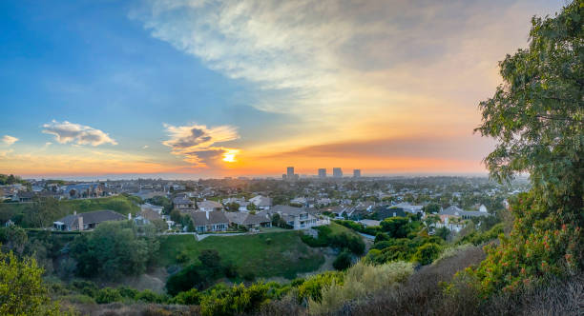

CALIFORNIA DEPARTMENT OF INSURANCE
CALIFORNIA DEPARTMENT OF INSURANCE (CDI)
SUSTAINABLE INSURANCE STRATEGY
Yolanda Diaz
Outreach Analyst,
Community Relations and Outreach
Notes:
Now, Let's take a look at the different types of coverages available within the Auto insurance
Liability Vs. Full Coverage

Slide 8
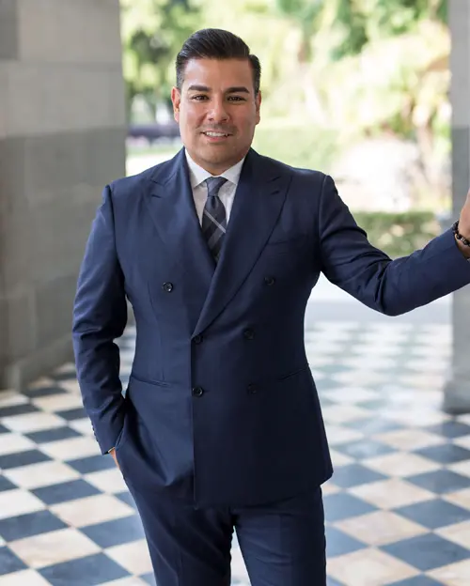
CALIFORNIA DEPARTMENT OF INSURANCE
MISSION:
TOP PRIORITY CONSUMER PROTECTION
  Enforce regulations on most lines of insurance and maintain insurer solvency
  Sets standards for agents and brokers licensing
  Resolve consumer insurance complaints
  Performs market conduct reviews of insurance companies
  Investigates and prosecutes insurance fraud
CONTRACT BASICS
Notes:
Life insurance is a contractual agreement between you (the policyholder) and an insurance company. You pay regular premiums, and in return, the insurer guarantees a lump-sum payout—called a death benefit—to your designated beneficiaries upon your passing, provided the policy is active
Financial protection: Life insurance helps loved ones cover expenses like funeral costs, debts (e.g., mortgage, credit cards), daily living expenses, childcare, and education
Contract basics:
You choose the type of coverage and death benefit amount.
Undergo underwriting (health checks, questionnaire).
Pay premiums (monthly, quarterly, or annually).
If you die while the policy is active, your beneficiaries receive the death benefit tax-free

Slide 9

EDUCATIONAL TOPICS
  Home, Renters, and Business Insurance
  Senior Scam Prevention
  Sustainable Insurance Strategy
  Safer from Wildfires
  Low-Cost Auto Insurance Program
  Emergency Preparedness and Recovery
  Market and Legislative Updates
Notes:
California Department of Insurance – Educational Presentations Overview
1. Home, Renters, and Business Insurance (General Education)
These presentations explain:
How insurance policies work
What is and isn’t covered
How to shop for insurance
How deductibles, exclusions, and endorsements work
How to file a claim and avoid common mistakes
They are designed for consumers, homeowners, renters, and small business owners.
2. New Entrepreneurs
CDI provides insurance education for new business owners, including:
Required insurance for businesses (workers’ comp, liability, commercial property)
Optional coverages (cyber, EPLI, business interruption)
How to evaluate risk and choose the right policies
How to avoid underinsurance
These presentations are often used by startups, small businesses, and chambers of commerce.
3. Sustainable Insurance Strategy
This program focuses on:
How climate change affects insurance availability
Wildfire and flood risk trends
State strategies to stabilize the insurance market
Consumer protections and regulatory updates
Useful for community groups, policymakers, and industry stakeholders.
4. Safer From Wildfire
A joint initiative between CDI, CalFire, and the Governor’s Office of Emergency Services.
Topics include:
Home hardening steps
Defensible space requirements
How mitigation affects insurance eligibility
New rules requiring insurers to consider wildfire‑risk improvements
This is especially relevant for homeowners in high‑fire‑risk areas.
5. Low‑Cost Auto Insurance Program
A state‑sponsored program offering affordable liability insurance to income‑eligible drivers.
Presentations explain:
Eligibility requirements
How to apply
Coverage limits
How the program helps uninsured drivers get legal and insured
Ideal for community organizations and consumer outreach events.
6. Emergency Preparedness
CDI provides preparedness education covering:
Creating home inventories
Understanding evacuation zones
Protecting important documents
Insurance steps to take before a disaster
Often used by cities, counties, and emergency‑response groups.
7. After a Disaster
These presentations help survivors navigate:
Filing claims
Understanding deadlines
Avoiding scams and fraud
Accessing state and federal recovery resources
Working with adjusters and contractors
Critical for post‑wildfire, flood, or earthquake recovery events

Slide 10
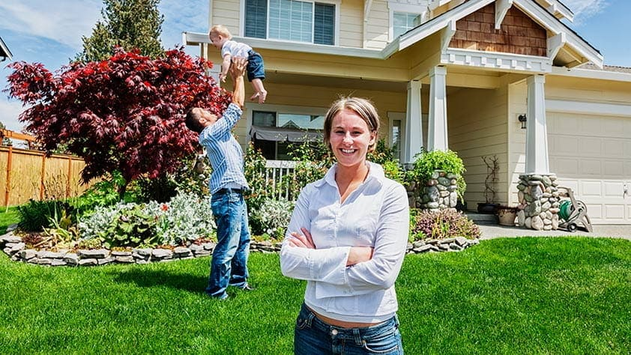
CALIFORNIA DEPARTMENT OF INSURANCE
HOMEOWNERS INSURANCE
AVAILABLE INSURERS
  Admitted Market
  Non-Admitted Market
  California FAIR Plan
ADDITIONAL INSURANCE
  Flood Insurance
  Earthquake Insurance
  Difference in Conditions Policy
Notes:
In insurance, “perils” are the specific causes of loss or damage that an insurance policy either covers or excludes.
Common covered perils
Fire and smoke
Theft or vandalism
Windstorm and hail
Lightning
Explosion
Falling objects
Water damage from burst pipes
Weight of snow or ice
Sudden & accidental damage (varies by policy)
Additional Living Expense (ALE)
Common excluded perils (often need special coverage)
Earthquakes
Floods (from natural water sources)
War or nuclear hazards
Wear and tear
Pest or mold damage
Intentional acts
Types of peril coverage
Named-perils policy: Only covers perils specifically listed in your policy.
Open-perils (all-risk) policy: Covers everything except what is excluded.

Slide 11


INSURANCE MARKET
  Prop 103 was the last Insurance Reform
(over 30 years ago)
  Historic Inflation
  Fewer Insurance Options
  Increasing Number of Natural Disasters
  Accelerated growth of the FAIR plan
  Cost of Reinsurance
TOP 12 COMPANIES DOMINATED 85% OF STATE’S HOMEOWNERS MARKET
SINCE 2022 – 7 OF THE TOP 12 INSURANCE GROUP HAD PAUSED OR STOPPED SELLING NEW POLICIES.
Notes:
California Low-Cost Automobile (CLCA) was Established in 1999 by the California Legislature under Insurance Code § 11629.7.
This program is state sponsored low-cost auto insurance model that expanded to all California residents.
The purpose is to provide affordable liability coverage exclusively for income‑eligible, good‑driver residents—helping them comply with California’s mandatory auto insurance law.

Slide 12

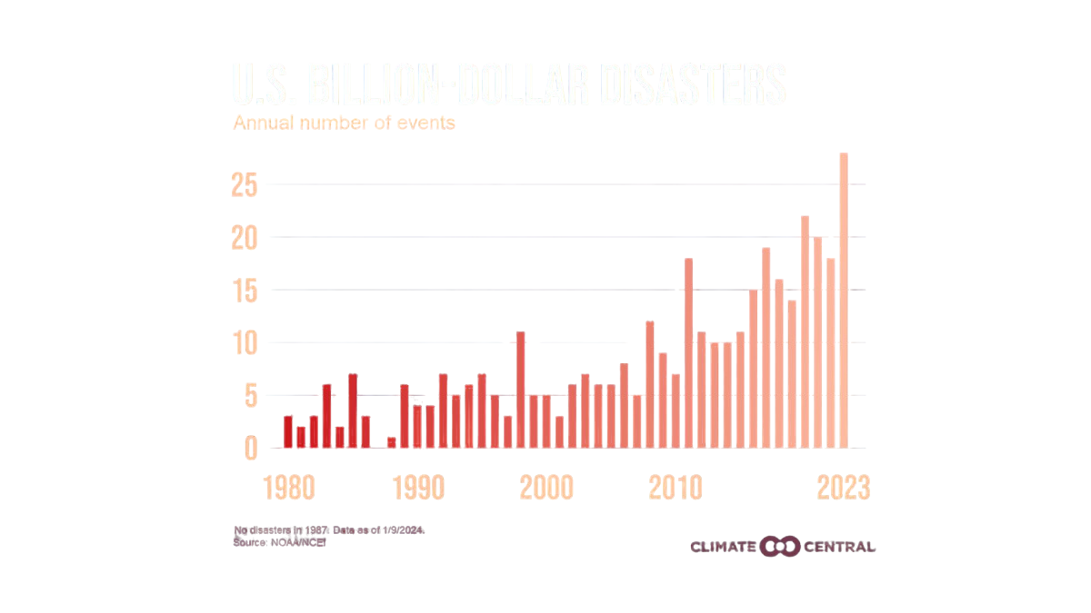
INSURANCE IN CONTEXT
CALIFORNIA CONTEXT
Over past 10 years, homeowners insurance companies have done far worse in California than nationally.
Direct incurred loss ratio (2012-2021)
Countrywide: 59.7%
California: 73.9%
Direct underwriting profit
Countrywide: 3.6%
California: -13.1%
Direct profit on insurance transactions:
Countrywide: 4.2%
California: -6.1%
Direct return on net worth:
Countrywide: 7%
California: 0.8%
Source: NAIC Profitability Report (released January 2023)
Source: National Oceanic and Atmospheric Administration| National Centers for Environmental Information

Slide 13
COMMISSIONER‘S RESPONSE
SAFER FROM WILDFIRES (2022)
SUSTAINABLE INSURANCE
STRATEGY
(2023-2024)
CALIFORNIA SAFE HOMES GRANT PROGRAM
(2025)
Mandates insurers offer premium discounts for homeowners implementing wildfire mitigations while rewarding risk reduction.
Uses catastrophe modeling for precise wildfire risk pricing, factoring in mitigation at property, community, and landscape scales to ensure market stability.
Grants for low-income homeowners in high fire hazard severity zones to fund defensible space and home hardening.
Notes:
Safer from Wildfires discounts require insurers to reward homeowners for hardened roofs and defensible space, feeding into the Sustainable Insurance Strategy, where models reflect real mitigation and support stable pricing in the voluntary market. CA Safe Home Grant Program (AB 888) offer grants for low‑income homeowners in high‑risk ZIP codes, which directly reduce modeled risk at the property level and provide tangible financial support.
These measures aren’t siloed, but they build momentum toward delivering available insurance coverage statewide. That brings us to the 2026 reforms, which aim to further expand insurance options, strengthen consumer protections, and enhance post‑disaster recovery.
3
More rights
Home Risk score
Non- renewals 75 days notice

Slide 14

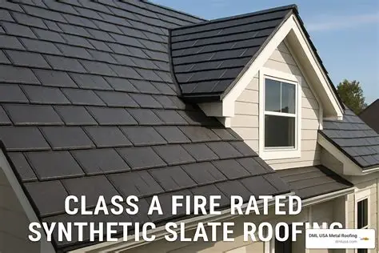
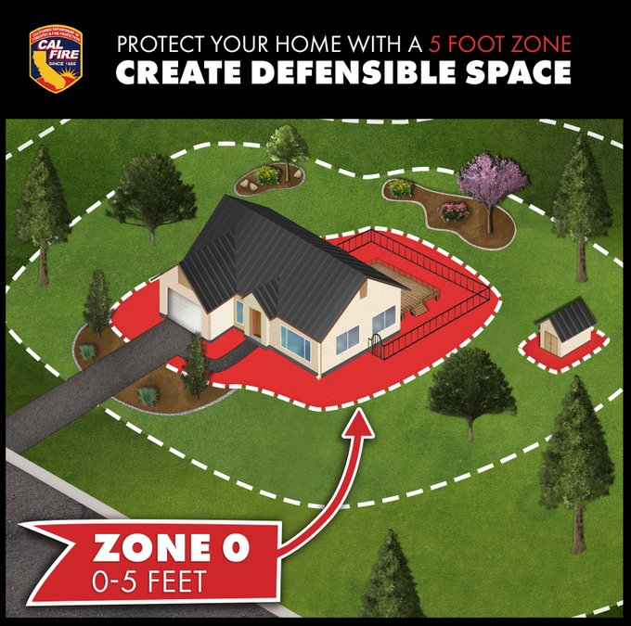
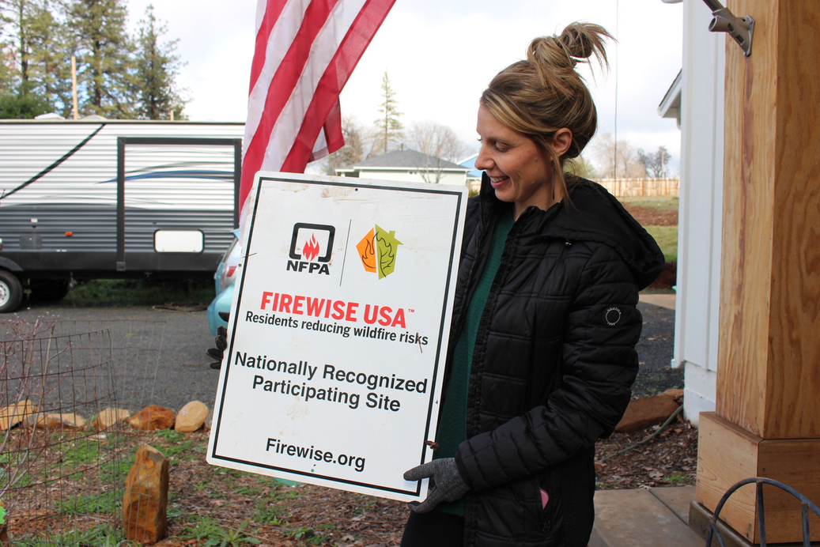
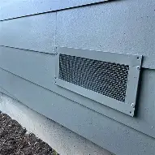
SAFER FROM WILDFIRES
PROTECT THE STRUCTURE, IMMEDIATE SURROUNDINGS & THE WHOLE COMMUNITY
PROTECT YOUR HOME OR BUSINESS:
PROTECT IMMEDIATE SURROUNDINGS:
PROTECT THE WHOLE COMMUNITY:
• Class A Fire-rated roof
• 5-foot ember-resistant zone
• Noncombustible 6‑inch area at
the bottom of exterior walls
• Ember and fire-resistant vents
• Upgraded windows (double-
paned or added shutters)
• Enclosed eaves
• Clear vegetation and debris
from under decks
• Remove combustible sheds
and other outbuildings
• Defensible space compliance
(trim trees, remove brush
and debris from yard)
  Achieve community-wide risk mitigation recognition as a Firewise or Fire Risk Reduction Community
  Minimun 8 dwelling units or as big as 2,500 can create an action plan and start being safer together.
Notes:
PROTECT YOUR BIGGEST INVESTMENT
In response of the insurance market safer from wildfire framework was created within the collaboration of CAL FIRE (California Department of Forestry and Fire Protection)
The Governor’s Office of Emergency Services (Cal OES)
The Governor’s Office of Planning and Research (OPR)
The California Public Utilities Commission (CPUC)
To ensure long‑term, comprehensive, and affordable coverage.
Safer from Wildfires discounts require insurers to reward homeowners for
hardened roofs and defensible space, (Zone Zero) feeding into
the Sustainable Insurance Strategy, where models reflect real mitigation and support stable pricing in the voluntary market.

Slide 15

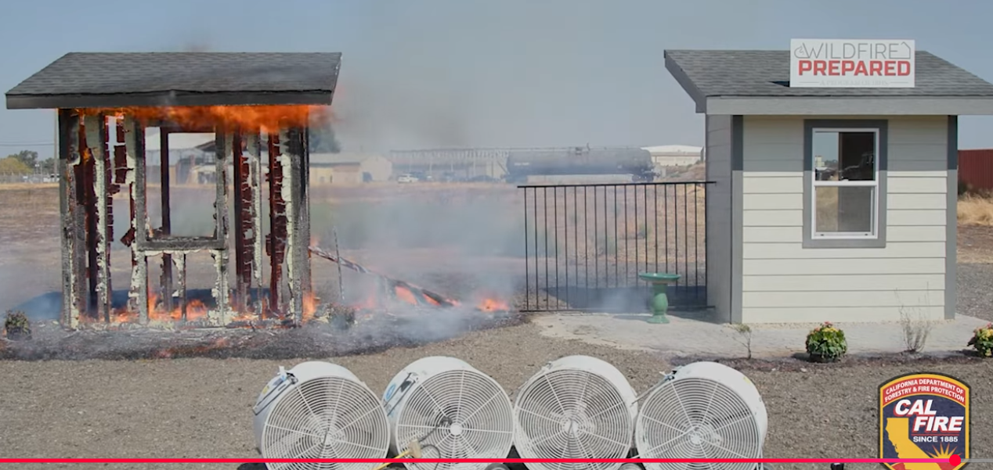
SAFER FROM WILDFIRES
KEY POINT:
Fortify homes through Safer from Wildfires one at a time to build wildfire resistant communities.

Slide 16
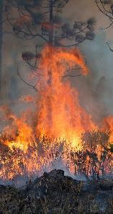
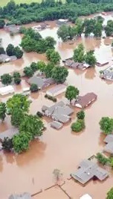
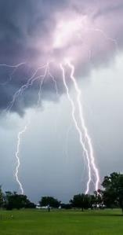
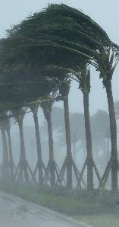
SUSTAINABLE INSURANCE STRATEGY
MODERNIZES INDUSTRY, MAKES INSURANCE ACCESSIBLE, MAINTAINS RESILIENT MARKET & PROTECTS CONSUMERS
MAJOR COMPONENTS:
  CATASTROPHE MODELS use technology to provide accurate pricing options
  MODERNIZES Department’s rate review process
  REQUIRES insurance companies to write in High Wildfire Severity Zones
KEY POINT:
AVAILABILITY OF INSURANCE WILL CREATE AFFORDABILITY
Notes:
A key component is the use of the Catastrophe model - a ratemaking tool. The models reflect real mitigation and support stable pricing in the voluntary market.
Expands coverage options through use of catastrophe modeling for improved wildfire risk analysis, factoring in mitigation at property and community to ensure market stability.
Verisk
Moody's
Karen, Clark & Company

Slide 17





1. CSAA
INSURERS UPDATES
Effective 3/01/2026
2. USAA (4 Companies)
Effective 4/30/2026
3. California Casualty
Under the Sustainable Insurance Strategy, 13 companies have committed to growing in California, with more insurers expected to follow.
Effective 5/1/2026
4. Mercury
Effective 7/1/2026
5. Pacific Specialty
Effective 7/1/2026
KEY POINT:
COMPANIES ARE NOW WRITING IN DISTRESSED AREAS
Notes:
We have 13
Sharing results from Sustainable Insurance Strategy
We have 6 companies committed to growing in CA
Through these efforts
(previous slide) we are moving towards the goal of
1.Modernize- Insurance Market Process
2. Ensure Accessible Insurance for all Californians
3. Create Resilient Insurance Marketplace and Protecting Consumers
Which is the purpose of the Sustainable Insurance Strategy

Slide 18
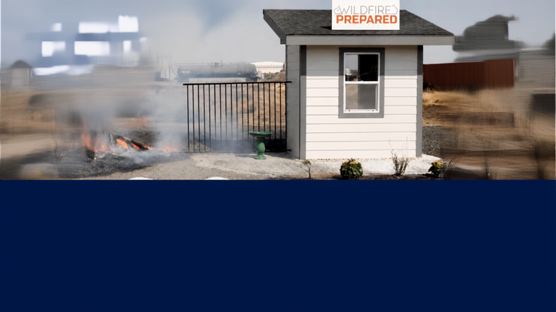



IBHS WILDFIRE
PREPARED HOME DESIGNATION
INSURANCE INSTITUTE FOR BUSINESS AND HOME SAFETY
PROGRAM
OVERVIEW
DESIGNATION
FEES
2- LEVELS
of wildfire‑resistant building and landscaping standards
Requires all upgrades to be completed with no exceptions.
3-YEAR DESIGNATION
Initial submission $125
Yearly Review
$25
(Annual review for max of 2 years)
2- Years
Annual review required
(photos submission)
Home must reapply for another 3 -year Designation
To take the survey and obtain more information go to:
https://wildfireprepared.org/
Notes:
7

Slide 19
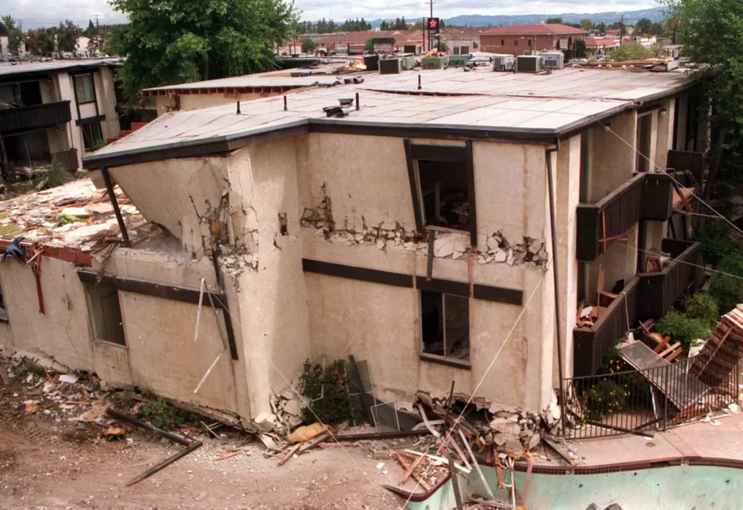
INSURANCE MARKET COMPARISON
1994 Northridge Earthquake
  90% of Insurance companies left the state
  CA Earthquake Authority created
  Despite California experiencing 90% of the nation's earthquakes, only 10-15% of homeowners have earthquake insurance
  Coverage Gap: most California residents opt out of coverage in the event of an earthquake
Notes:
Fearing bankruptcy 90% of Insurance Companies left the state CA Earthquake Authority created.
Low Take-Up Rate: Despite California experiencing 90% of the nation's earthquakes, only 10-15% of homeowners have it.
Coverage Gap: The low uptake leaves a large percentage of California residents exposed to significant financial risk if a major earthquake occurs.

Slide 20
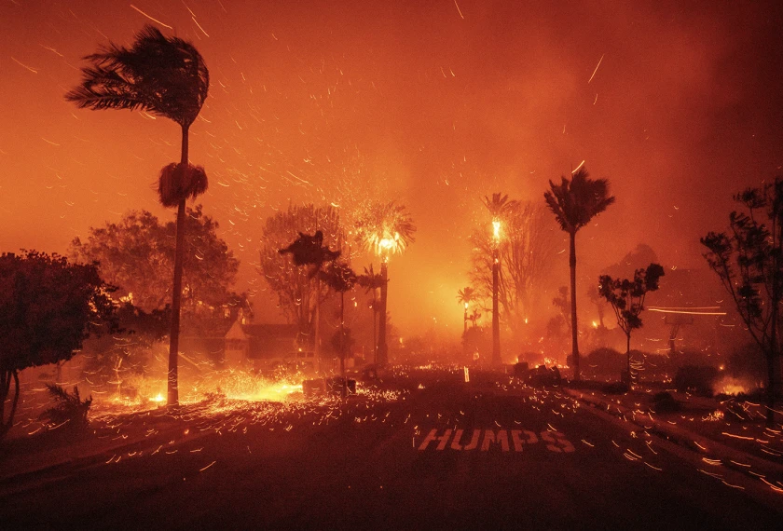
INSURANCE MARKET COMPARISON
2018 CAMP FIRE - 2025 LA FIRES
  SAFER FROM WILDFIRES
    Mitigation Strategies
    Wildfire Risk Score Transparency
  SUSTAINABLE INSURANCE STRATEGY
    Integrates Catastrophe Modeling
    Expands Coverage Availability
    Modernizes FAIR Plan
    Streamlines Rate Filings
LONG-TERM GOAL: PREVENT A TOTAL MARKET COLLAPSE AND STABILIZE INSURANCE RATES
Notes:
Introduction to ....
Safer from Wildfire
Sustainable Insurance Strategy
Longterm Goal:

Slide 21
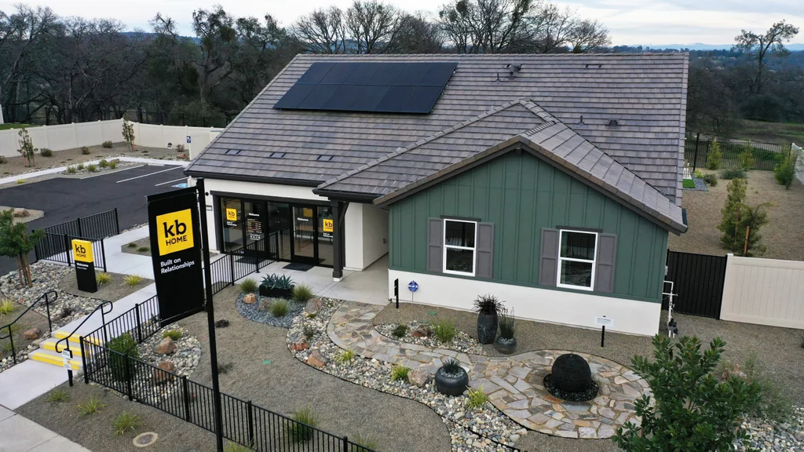
INSURANCE MARKET COMPARISON
  MARKET VOLUME:
    California’s insurance market is immense, with annual insurance premiums exceeding $332 billion.
  GLOBAL POSITION
    California’s insurance market ranks behind China, United Kingdom and the rest of the United States
  U.S. MARKET RANK
    California remains the largest insurance market in the United States.
4TH LARGEST INSURANCE MARKET GLOBALLY
Notes:
Introduction to ....
Safer from Wildfire
Sustainable Insurance Strategy
Longterm Goal:

Slide 22
CA FAIR PLAN
APPROVED RATE INCREASE – EFFECTIVE OCTOBER 15, 2026
RENEWING ON OR AFTER OCTOBER 15, 2026?
FAIR plan rate will increase — for their overall book of business - May be higher if you live in a wildfire‑risk areas.
WHAT DO I DO NOW?
TREAT THE FAIR PLAN COVERAGE AS A TEMPORARY SOLUTION,
NOT A PERMANENT HOME INSURANCE CHOICE IF POSSIBLE
  Consult your broker immediately
  Use our insurance finder tool, top 10 tips for finding residential insurance guide
  Keep records of your improvements and communications
INSURANCE CONCERNS?
CALL: 800-927-4357
WWW.INSURANCE.CA.GOV
  FIRE SAFETY Improvements receive up to 16.4% discount
Notes:
“Under Prop 103, insurance companies can ask for a rate change, but they do not automatically get with a request.
“The department reviews the company’s data, challenges unsupported costs, and only approves rates that comply with Prop 103 and California law, and are justified.
“Commissioner Lara has introduced several reforms to make this process more transparent, so consumers have more information and more power in this process.”
Overview of the Rate Increase
• The California FAIR Plan approved a 29.1% average rate increase effective October 15, 2026, down from the 35.8% originally requested .
• Policyholders in high wildfire-risk zones may see their wildfire premium portion double .
• Around 80% of policyholders will experience increases between 5% and 60%, while some may even see decreases if they're in lower-risk areas .
What To Advise Consumers
• Don't wait—your renewal is automatic. Policies renewing on or after October 15 will see new rates applied by default .
• Consult your broker immediately:
o Ask if private-market insurers (like Mercury, CSAA, Travelers, Farmers) are offering policies in your area under California’s Sustainable Insurance Strategy .
o Explore Difference in Conditions (DIC) coverage to supplement the FAIR Plan's fire-only policy—it doesn’t include liability, water damage, theft, etc. .
• Look into home hardening discounts:
o If you've installed fire-resistant improvements (e.g., ember-resistant vents, Class A roofing), you may be eligible for up to a 16.4% discount on wildfire premiums—verify with your broker and insurer .
• Shop around annually—the FAIR Plan is a temporary, last-resort option. As private insurers re-enter your area, you may be able to find better value .
• Understand your coverage limitations: FAIR Plan policies provide basic fire, lightning, and smoke coverage only. You'll need separate policies for other perils .
Consumer Action Checklist
• ✔️ Check renewal date and note effective October 15 increase.
• ✔️ Contact broker to assess private-market options.
• ✔️ Inquire about home hardening discounts and documentation needed.
• ✔️ Evaluate adding a DIC policy for full protection.
• ✔️ Review premiums and coverage annually—FAIR Plan is not a permanent solution.
Messaging for Public Communications
• “If your policy renews on or after October 15, 2026, your FAIR Plan premium will increase—by an average of 29.1%, possibly more if you're in a wildfire-risk area.”
• “The FAIR Plan covers only fire, lightning, and smoke—you’ll need additional policies for full homeowners protection.”
• “Home hardening measures may qualify you for valuable fire discounts—check with your insurance provider.”
• “Ask your broker if private-market options are now available in your ZIP code—they may offer better pricing.”
• “Treat FAIR Plan coverage as a temporary solution, not a permanent home insurance choice.”
CDI Support & Resources
• Direct consumers to the CDI website for FAIR Plan info, complaint procedures, and insurer directories.
• Provide CDI helpline for assistance with FAIR Plan issues: [insert CDI contact].
• Encourage consumers to document all improvements and track communications with brokers and insurers.

Slide 23

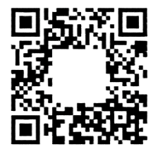




LEGISLATIVE SPONSORED BILLS
INTERLOCKING LEGISLATIVE STRATEGY FOR IMPROVING POST-DISASTER RECOVERY
1
2
3
SMOKE DAMAGE RECOVERY ACT
DISASTER RECOVERY REFORM ACT
MAKE IT FAIR ACT
AB1795-Assemblymember Gipson
SB876- Senator
Padilla
AB1680-Assemblymember Calderon
Smoke damage restoration standards
Coverage gaps and policy clarity
FAIR Plan reform and accountability
Notes:
7

Slide 24
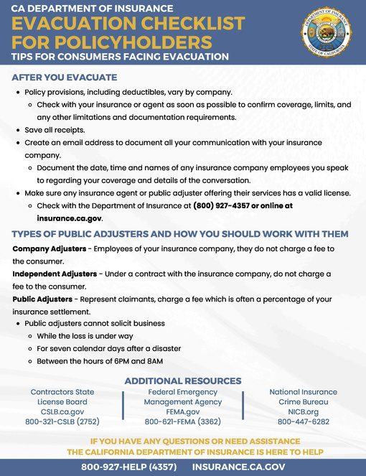
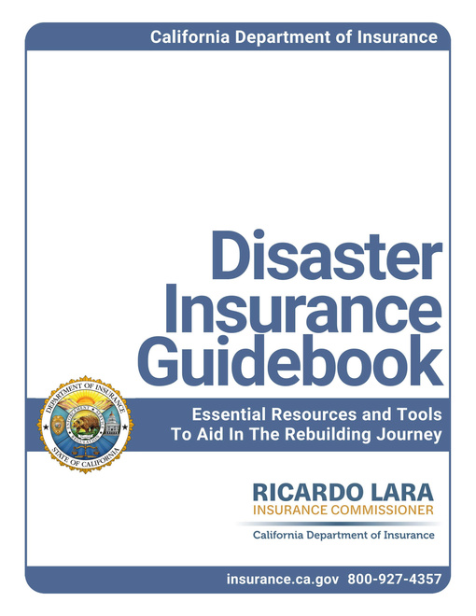
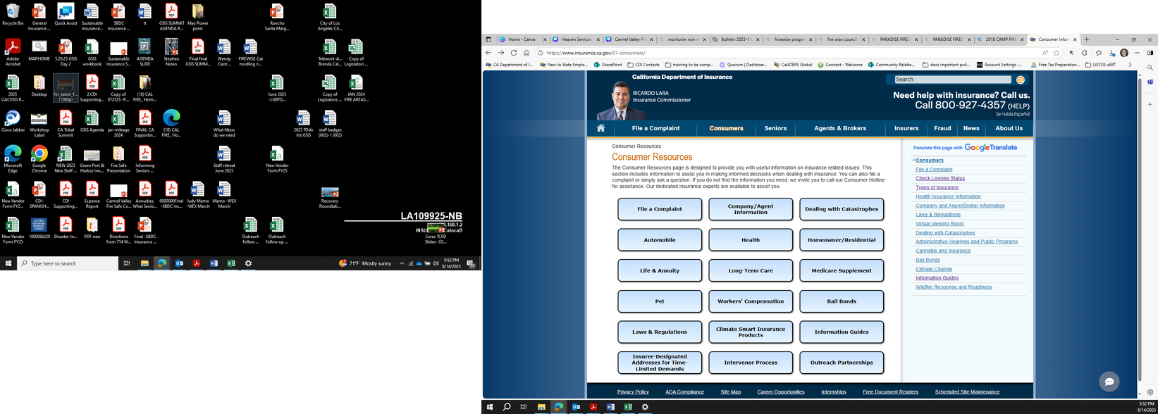
CDI RESOURCES
  Understanding your Policy
  Cancellation Notices
  How to Start a Claim
  Complaints regarding your Claim
  Home Inventory Guide
  Find over 100 Admitted Carriers
  CA Low Cost Auto Insurance Program
  Senior Gateway
  Information Guides
  General Questions
  Home Hardening Grants
www.insurance.ca.gov

Slide 25
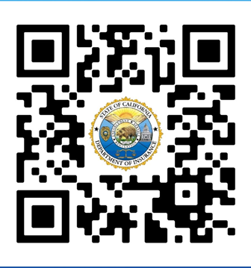
CONSUMER ALERTS
NEW REGULATIONS,
CONSUMER SAFETY EDUCATION,
FRAUD PREVENTION,
UNFAIR AND DECEPTIVE BUSINESS PRACTICES,
INSURANCE ISSUES
STAY INFORMED
SIGN UP!
www.surveymonkey.com/r/CDIALERT

Slide 26

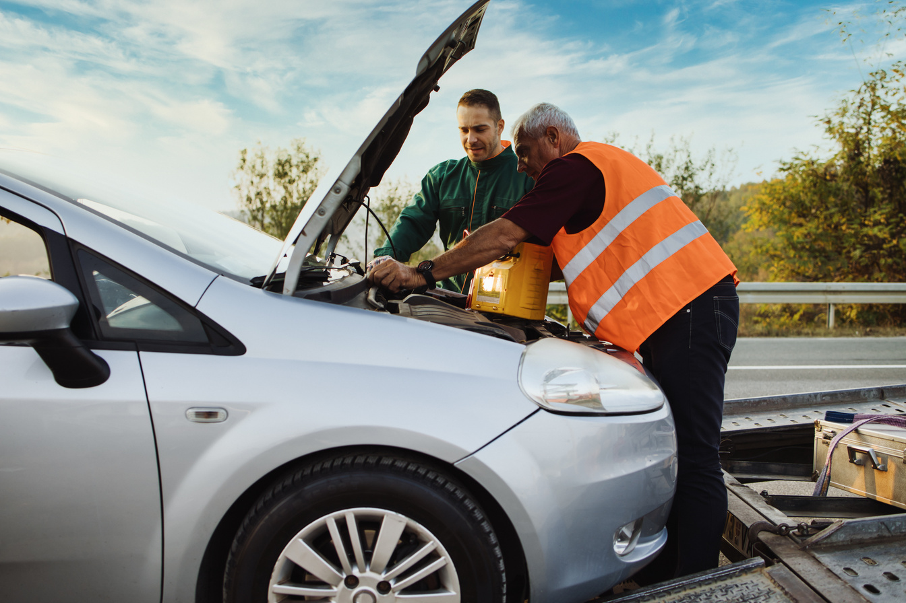


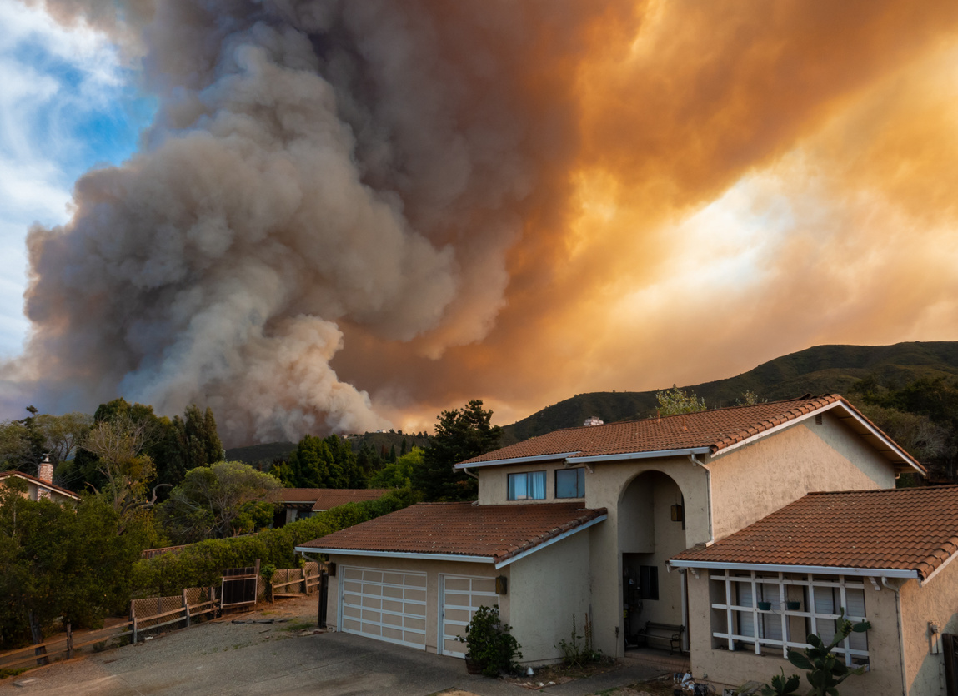

STATEWIDE
EDUCATION SERIES
TOPICS & DATES
RECORDINGS
JOIN US :
October 21
Auto Insurance
Business Insurance
Life Annuities & Seniors
Residential Insurance
Share with your networks.
qrco.de/CDI2026
Health Insurance

Slide 27
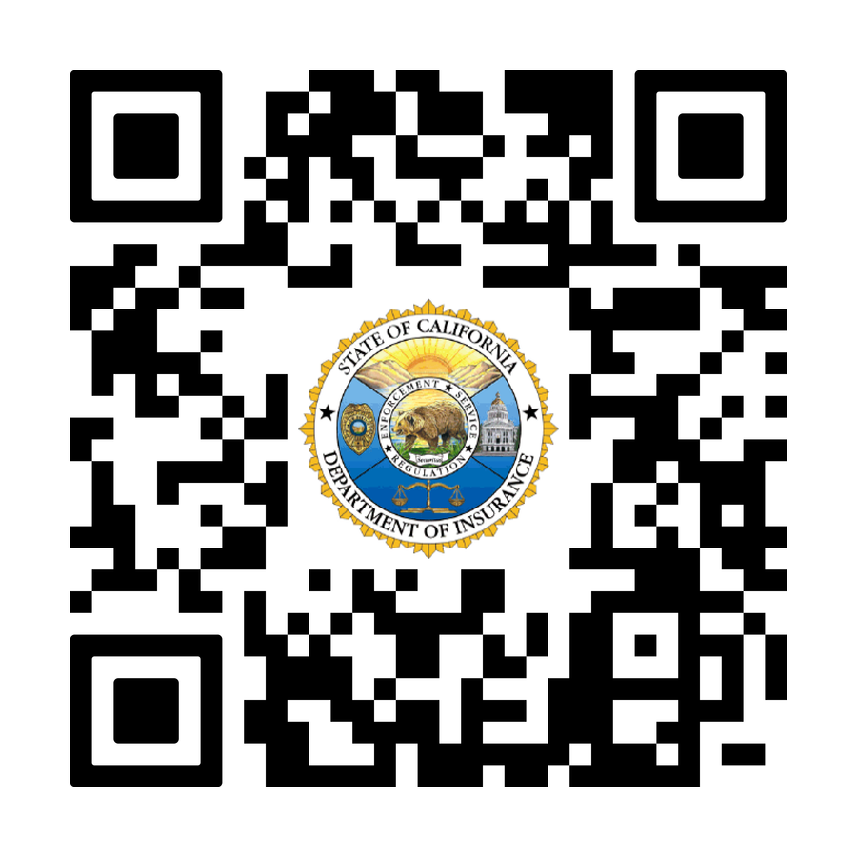
WE CARE ABOUT WHAT YOU THINK
WE CARE ABOUT WHAT YOU THINK
PLEASE GIVE US YOUR FEEDBACK:
NAME
Title
Community Relations and Outreach
PLEASE GIVE US YOUR FEEDBACK:
YOLANDA DIAZ
Outreach Analyst
Community Relations and Outreach
qrco.de/psurvey26
For GENERAL QUESTIONS AND POLICY SPECIFIC INQUIRIES:
CALL 800-927-4357
www.insurance.ca.gov
Notes:
9

Slide 28

Bill Mullins
VP, SEH Fire Safe Council
Local Firefighter

Slide 29
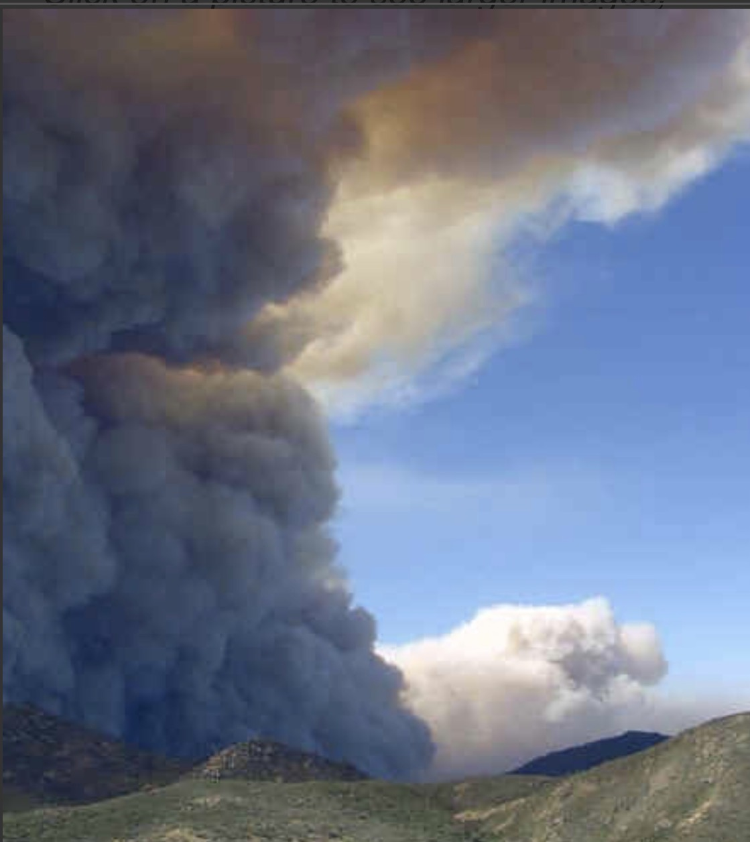
Evacuations and Decision Making Under Stress

Slide 30
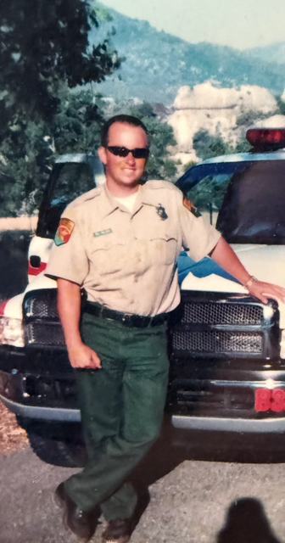
About Me
Bill Mullins
SEH Resident since 2008 (Calistoga)
Fire Safe Council VP
San Bernardino County Fire 1996-1999
Cal Fire 1999-2000
AMR Ambulance 2000-2003
Carlsbad Fire Department 2003-Now
Notes:
Welcome residents. Explain that this training is designed to help families make calm, early, and organized evacuation decisions during wildfire events.

Slide 31
Scenario
You are on your way home from work, you see smoke to the east out towards Harmony Grove. It’s been windy and hot all day. You feel a little anxious but you’re doing ok. As you come up SEH Rd. at the Town Square, you are seeing numerous fire engines and police headed towards the fire. It adds a little more anxiety. As you come up your street, you get a notice for an Evacuation advisory (Level 1). You start to worry. You start to run through your head about what you’re going to do. You start to question when you should leave. The stress builds. You decide to stay even though you are starting to see a little ash fall outside. A few minutes later, you start grabbing some personal items and you pack a bag of clothes. It also is starting to get a little darker and hazier outside. Five more minutes pass. You then get another notification. It’s now an evacuation warning (Level 2). You come to realize that you need to leave. Where are you going to go? What are you going to bring with you? You hear sirens outside, in the distance, with the “High-Low” tone. Your phone buzzes again with an evacuation order (Level 3). You’re so full of adrenaline that your hands are shaking, you can’t find your keys. They’re in your pocket. You get in your car and you head out the same way you always do. Embers are blowing in the air and it is dark as night outside. You get to the bottom of the street and there’s a bush and a pine tree on fire. Traffic is stopped and you have nowhere to go. You start thinking, “What did I get myself into?”

Slide 32

Why Evacuations Go Wrong
What Went Wrong Here
Letting our emotions affect our decision making
Waiting too long to leave
  Thinking 'it won’t reach us'
  Traffic congestion
  Routes becoming blocked
No Preplanning for this evacuation
  The time to plan for an evacuation is now, not when the emergency happens
  Bringing too much
Notes:
Explain that most evacuation problems happen because people delay leaving. Emphasize that leaving early keeps options open.

Slide 33

How Does Stress Affect Us
Sympathetic Response
  Tunnel vision
  Loss of complex reasoning
  Denial or hesitation “This isn’t happening”
  Rushing without thinking
  Freezing under pressure and not making a decision
  Adrenaline takes over
  Bad decisions happen
Notes:
Reassure residents these reactions are normal. The goal is to manage stress with a simple system.

Slide 34
How Do I Prevent This?
Plan Ahead
  Know what you are going to pack
  Know where you are going to go during an evacuation
  Know how you are going to get there
Be Ready When it’s Time to Leave
  Back your car into your driveway
  Have your car packed and ready
  Be dressed for the evacuation
Leave Early
  Don’t wait until it’s too late

Slide 35
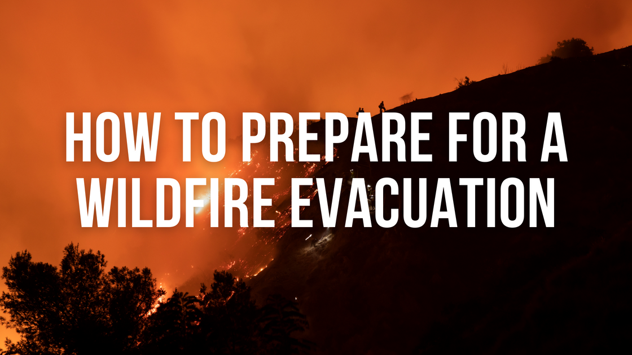

Slide 36

Evacuation Planning
Use the PACE acronym for planning your route
Use the STOP acronym for when you feel stressed
Know where your fire is and where it’s going
Evacuate Early, Evacuate Early, and Evacuate Early

Slide 37

PACE: Your Evacuation Layers
Primary Route – First way out
  Main Road
  Will be most crowded
Alternate Route – Backup road
  Secondary route out of town
Contingency – Safe open area
  Parking lots, Ball Fields, Parks and Schools
Emergency – Last resort shelter option
  Take refuge in a TRA (Hardened Structure, large open area or interior area of a neighborhood)
  Know Your PACE!
Notes:
Explain that every household should know at least two ways out before a fire happens.

Slide 38
The STOP Method
Use STOP when you get overwhelmed by adrenaline
S - Stop
  Take a few deep breaths and try to settle down (Box Breathing)
T - Think
  Focus on what you’re doing
O - Observe
  Try to get a read on where the fire is and how much time you have
P - Plan
  Come up with a plan for what you are going to do
  Stay Calm, Think Clearly and Act Decisively!
Notes:
Explain each step in simple language. Encourage families to use STOP anytime conditions change.

Slide 39
“Reading the Fire”
Where is it, How big is it and which way is it headed?
Where is it?
  Look to see if you know where it is
  Use an app like Genasys Protect, Watch duty or Wildfireintel.org to see the location and get information
  Utilize the Double Peak camera online
What size is the fire?
  Can You see it? Is it Small, Large, Catastrophic
  Read the smoke column
Which way is it headed?
  If you stand looking at the fire and the wind is blowing in your face, the wind is pushing that fire towards you.
  Look up, if the smoke is coming over you, the fire is coming your way.
  It will also follow topography and slope

Slide 40

Here’s how you evaluate your Situation
Smoke in the far distance, no advisories or warnings
  Monitor the fire
  Is the smoke coming towards you or away from you
  Be Ready
Smoke coming in your direction and the smell of smoke
  With Advisories or warnings, Danger… you should leave
  No Advisories or warnings and it’s far away, you can still monitor your situation, but be packed and ready to leave
  Best bet is to Evacuate
Thick, fast-moving smoke with ash or embers
  High Danger… You waited too long
  Evacuate immediately or take refuge
Notes:
Teach residents to use smoke as an early warning system.

Slide 41
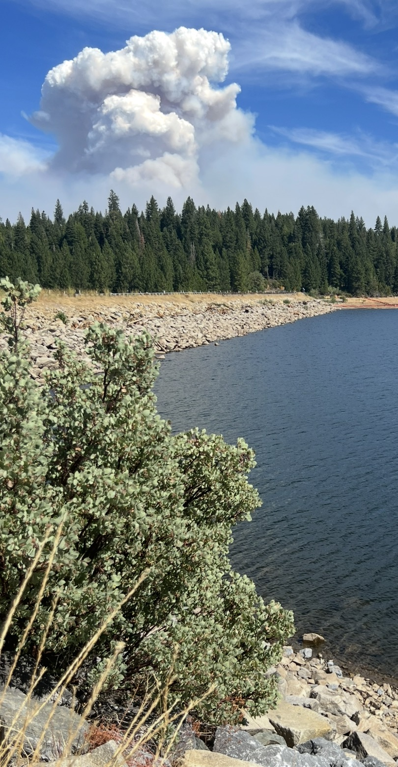
Smoke in the distance

Slide 42
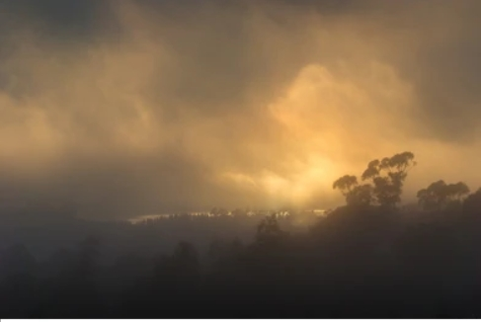
Smoke in the distance headed your way with some haze and smell of smoke

Slide 43
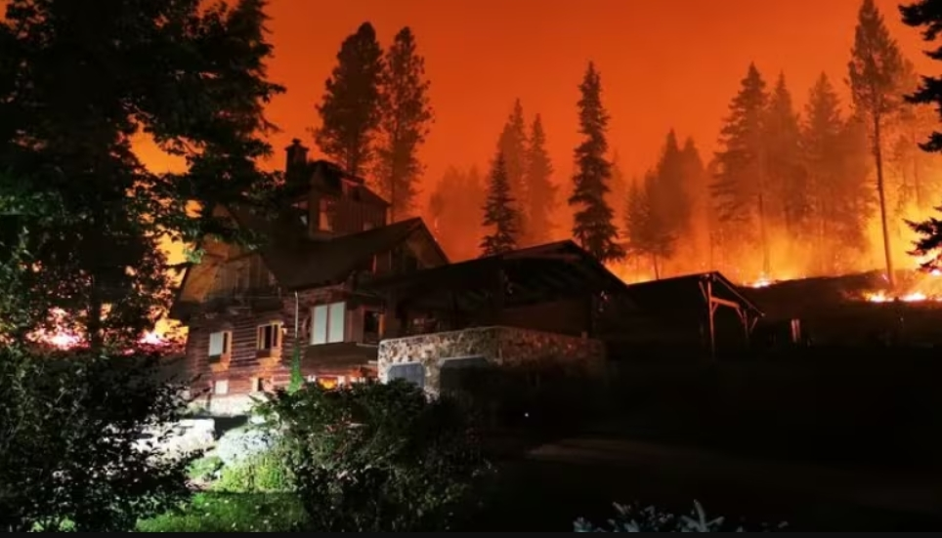
Smoke, ash and embers

Slide 44
Dressing for Evacuation
The fire doesn’t care about fashion
Dress in clothes made of either 100% wool or cotton.
  Denim Jeans, Cotton long sleeved shirt, flannel shirt and wool or cotton socks. Wear gloves to protect your hands. Wear shoes or boots. No flip flops, no crocs
  Have a ball cap to wear to protect your head.
  Bring a bandana to wear over your face if things get bad.
  Have these items readily available and planned out
  Do not wear anything synthetic. Yoga pants, board shorts and flip flops are not good for fires.

Slide 45
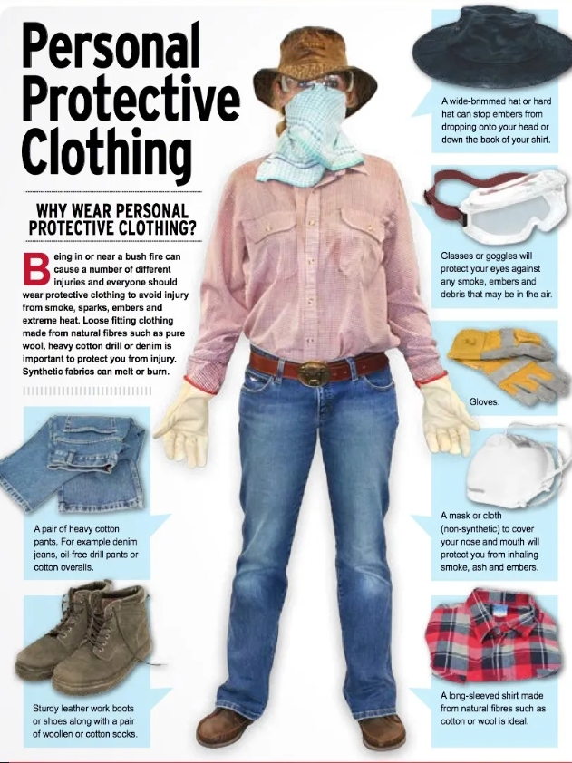
Dressing for evacuatuion

Slide 46
Items to have in your car
These are good to have:
A heavy wool blanket
Extra water to drink
Fire Extinguisher
Bolt cutters

Slide 47
Family Discussion Scenario
Give them the scenacrio I gave you earlier
  Share with them what you learned here
Have a family plan
  Where are you going to meet up at?
  What are you going to bring?
  Leave early, you can always come right back if things change
Notes:
Ask residents: When would you leave? When would you switch routes? Encourage discussion and proactive thinking.

Slide 48
THE END

Slide 49
Lindsey Smith
President, SEH FSC
President, SEH HOA
City of San Marcos Planning Commissioner
CALFIRE QE Defensible Space Assessor

Slide 50
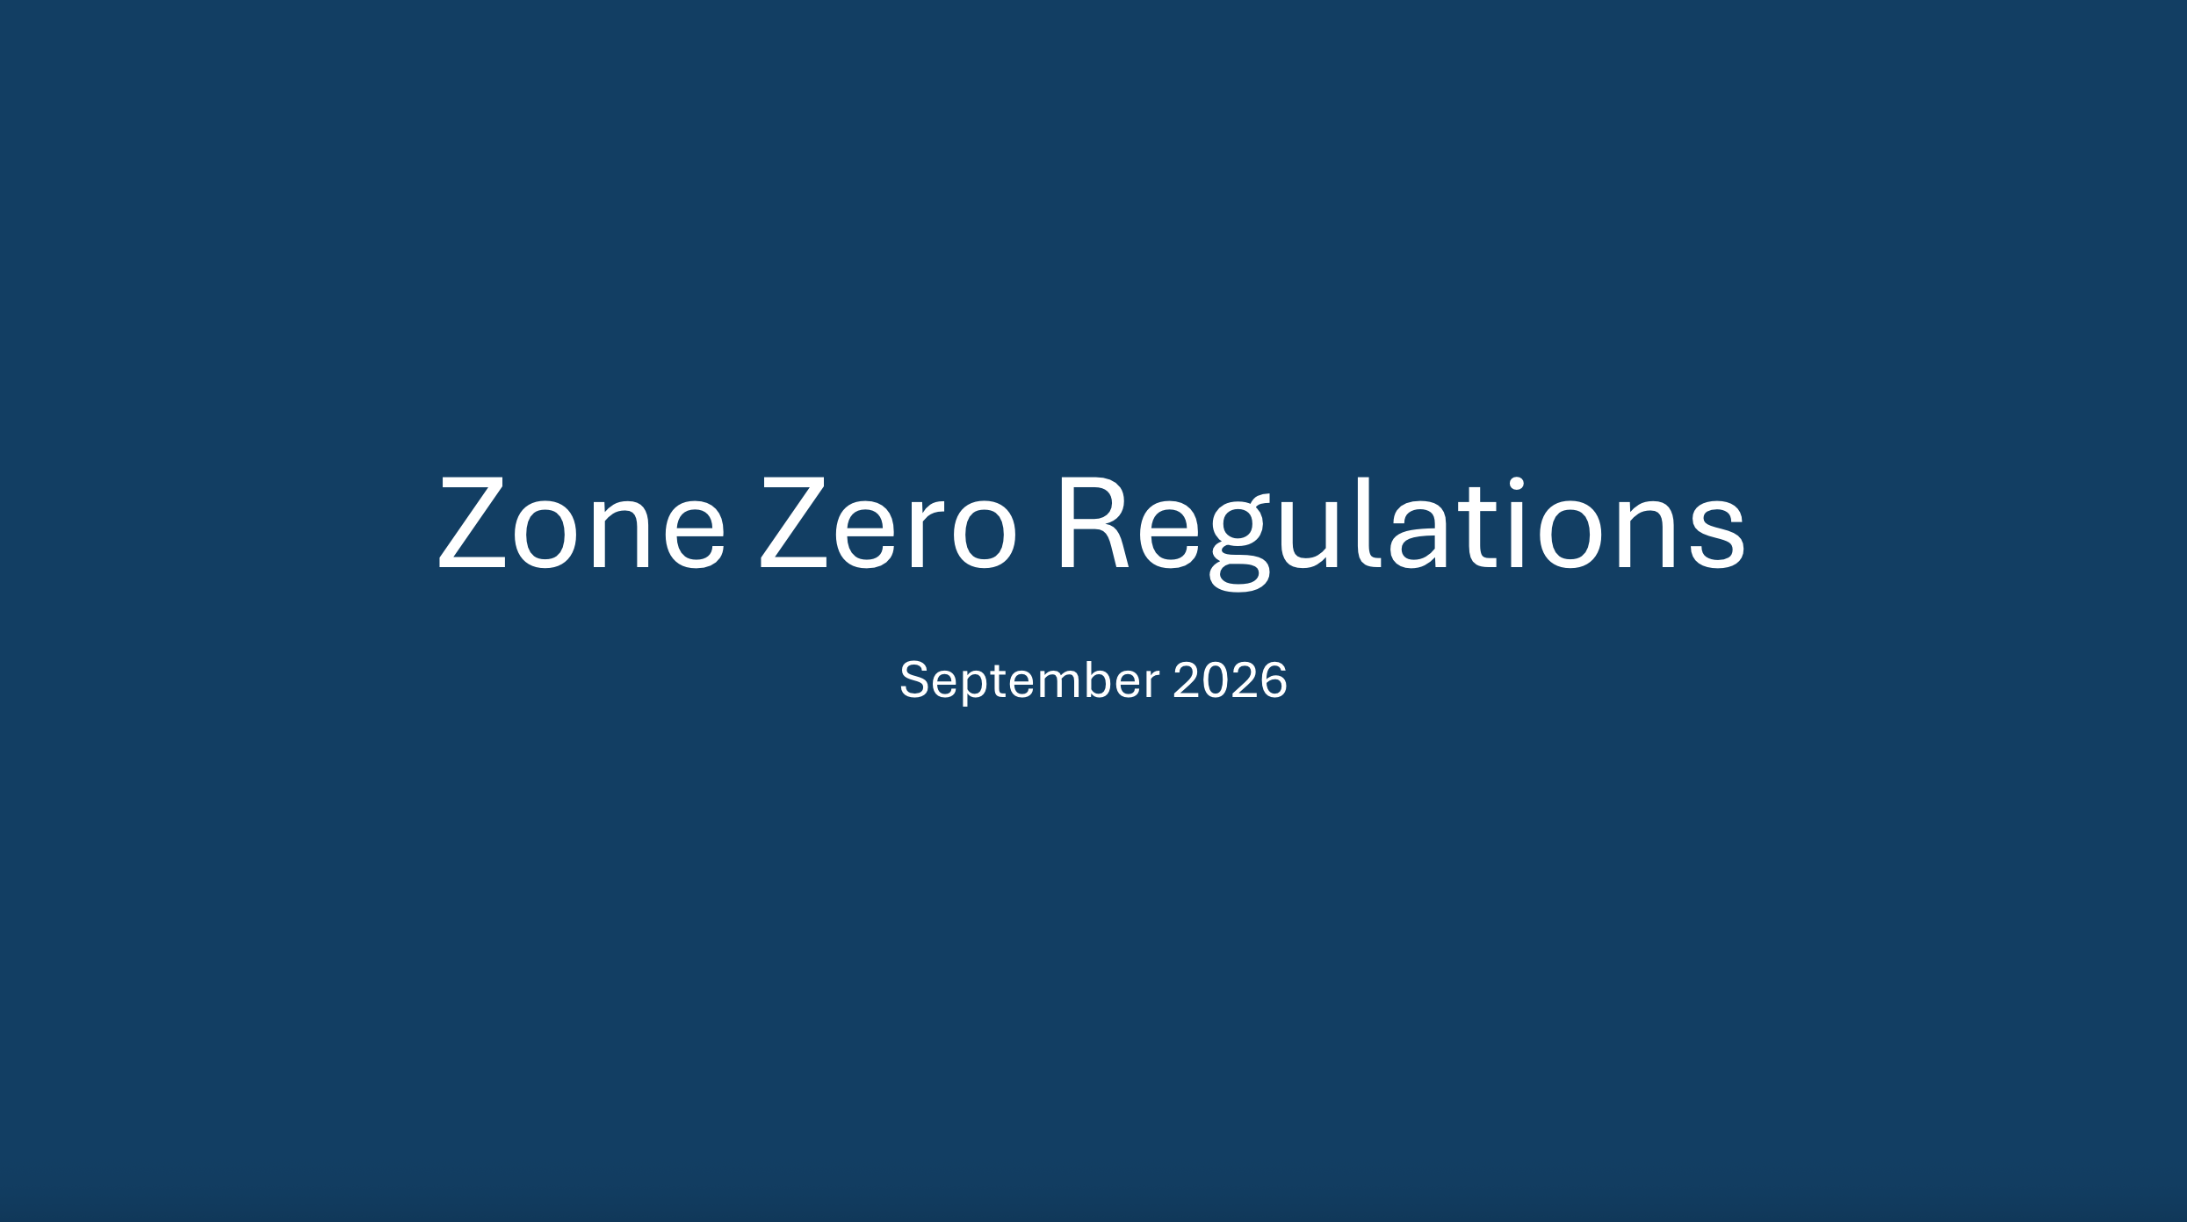

Slide 51
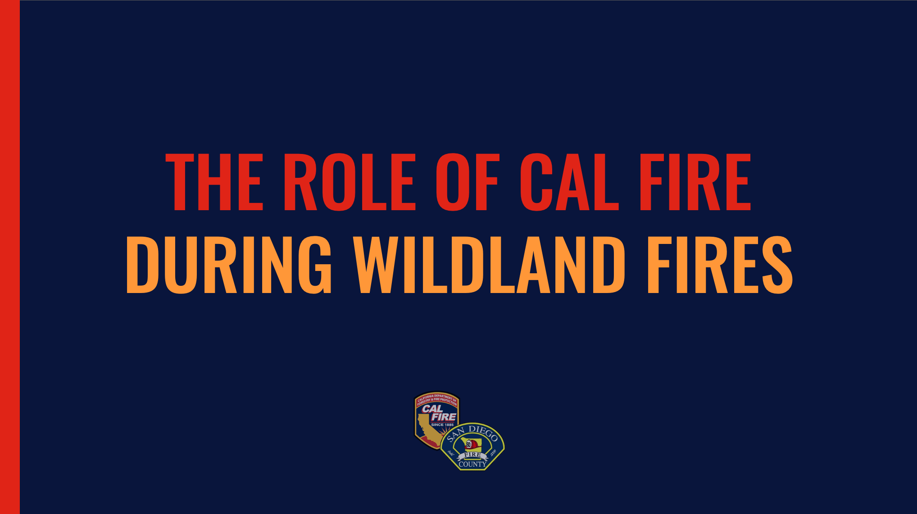
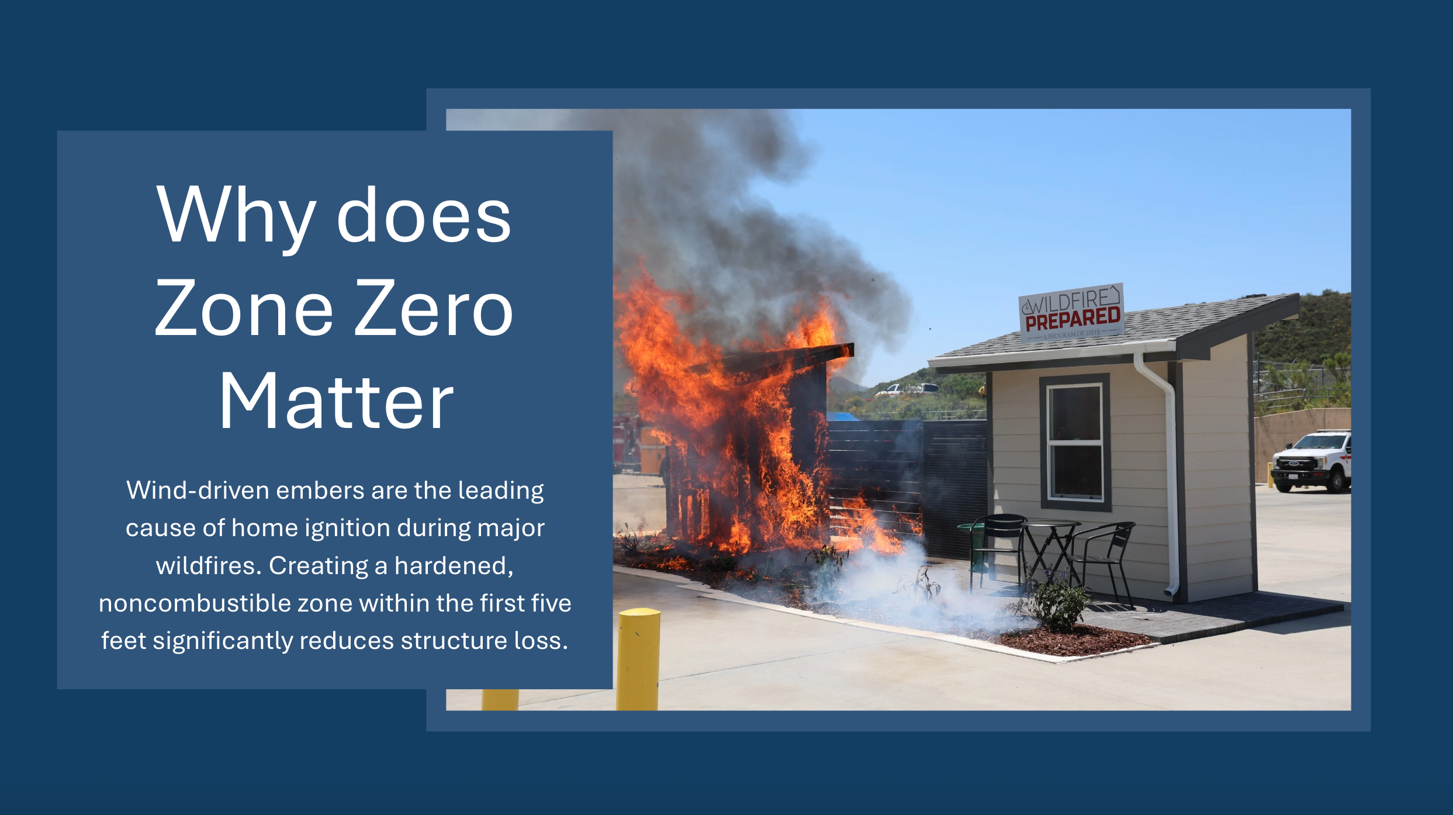
Video Link

Slide 52
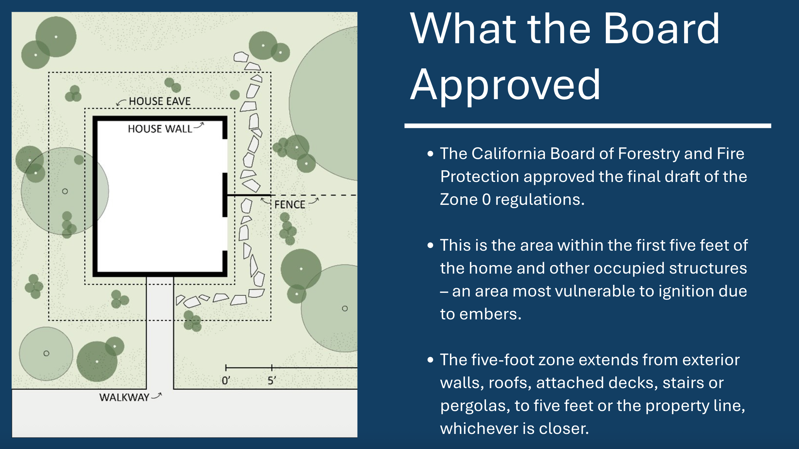
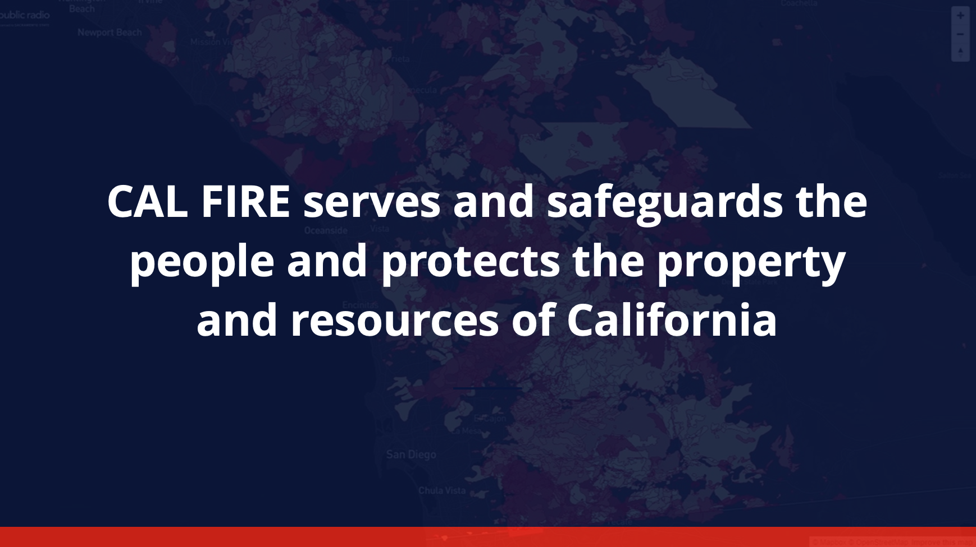

Slide 53
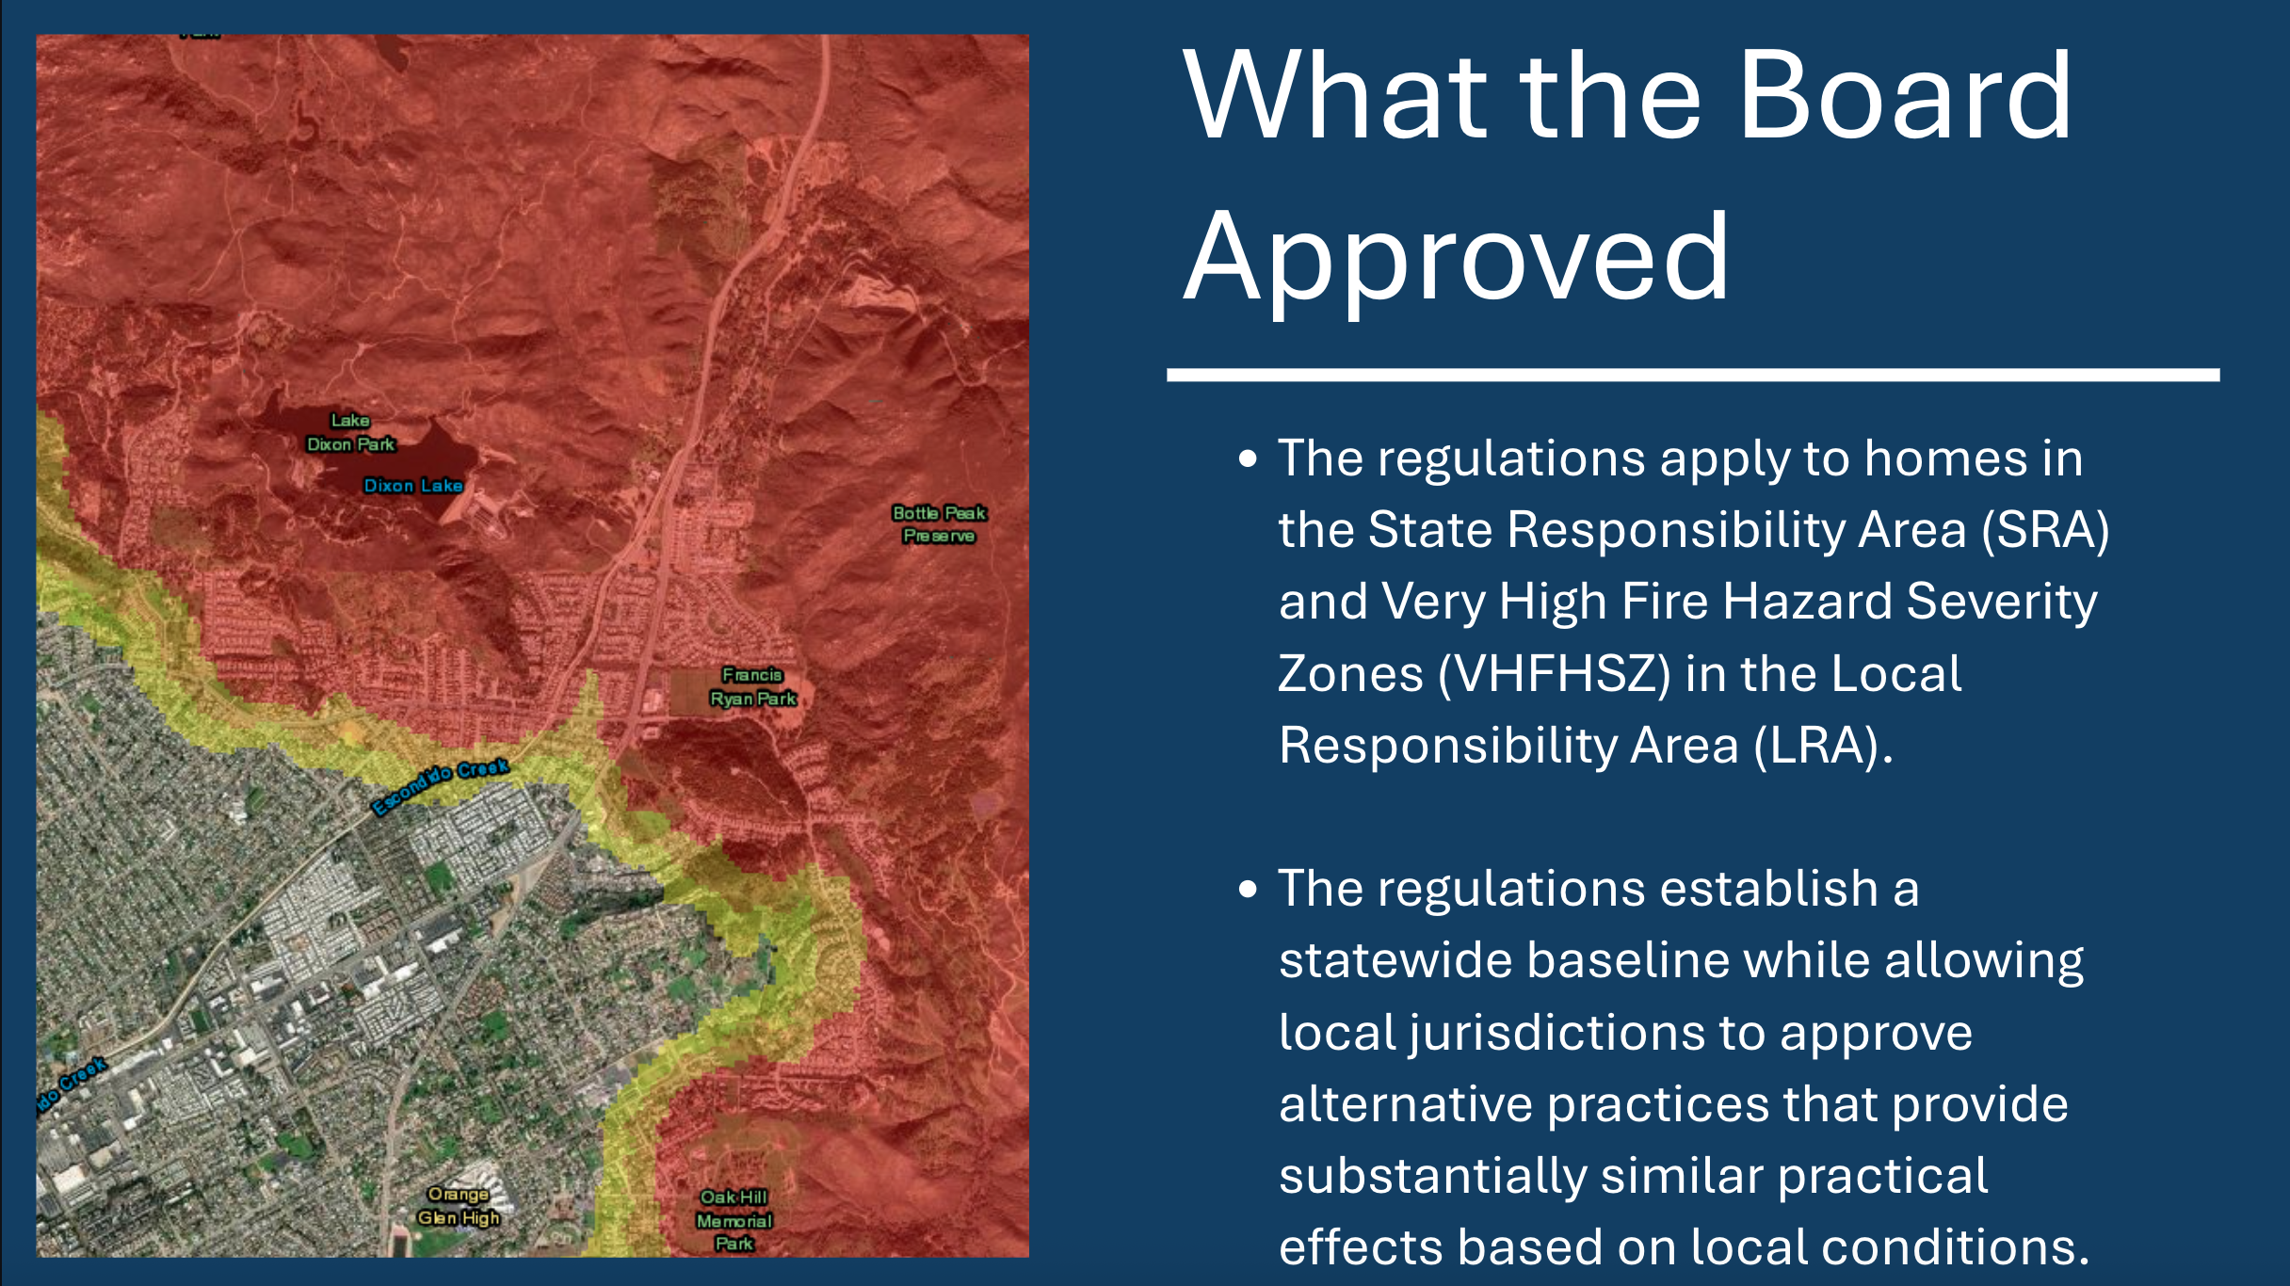
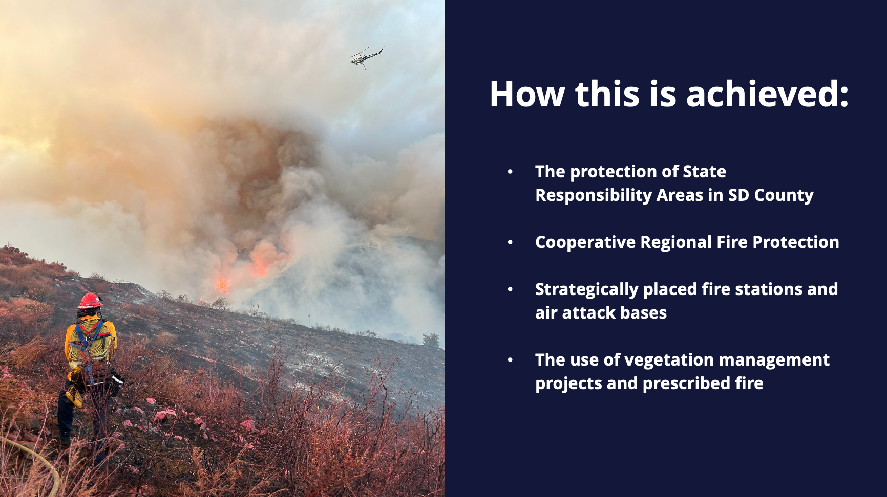

Slide 54
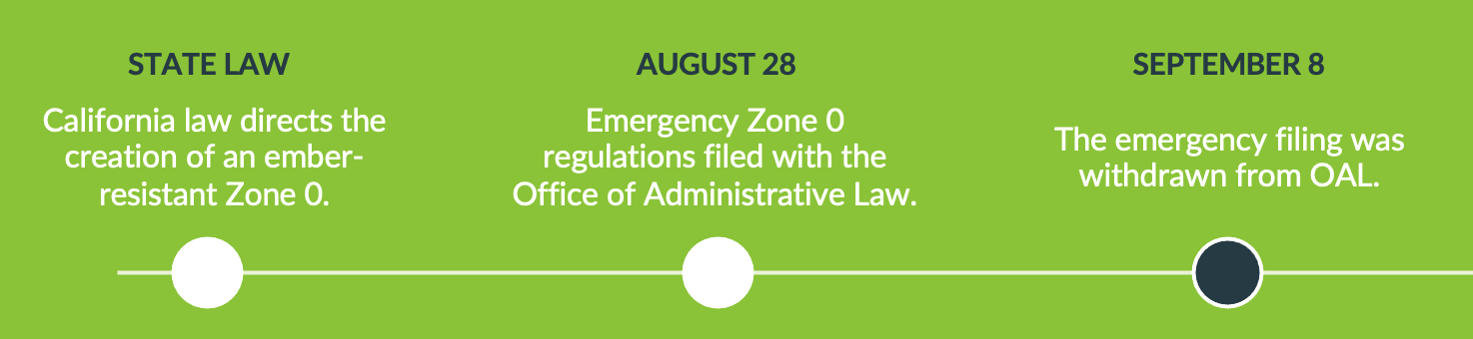
When will Zone 0 Take Effect?
What this means for Homeowners
More time. More resources. A chance to prepare.
Use this time to take manageable steps toward a more fire-resilient home while taking advantage of available insurance discounts, grants and funding opportunities that can help offset the cost.
Small steps now can make bigger changes easier later.

Slide 55
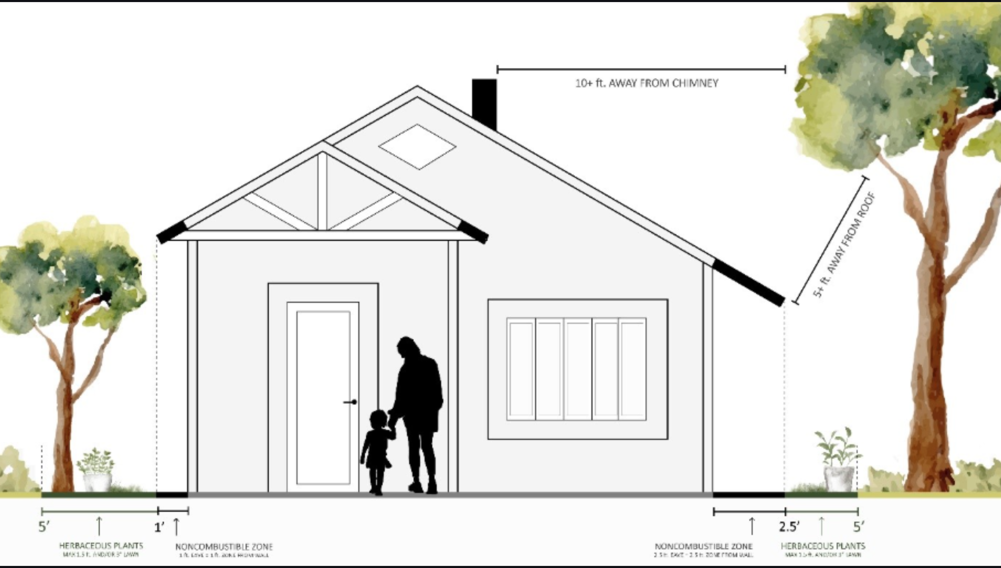
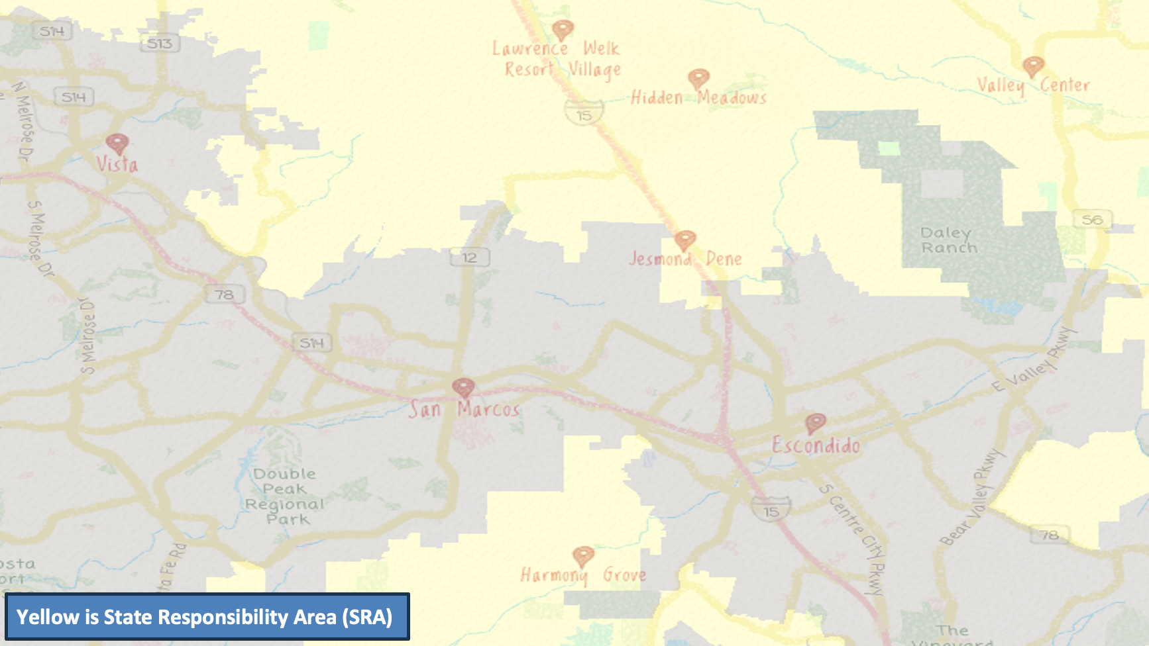

Slide 56
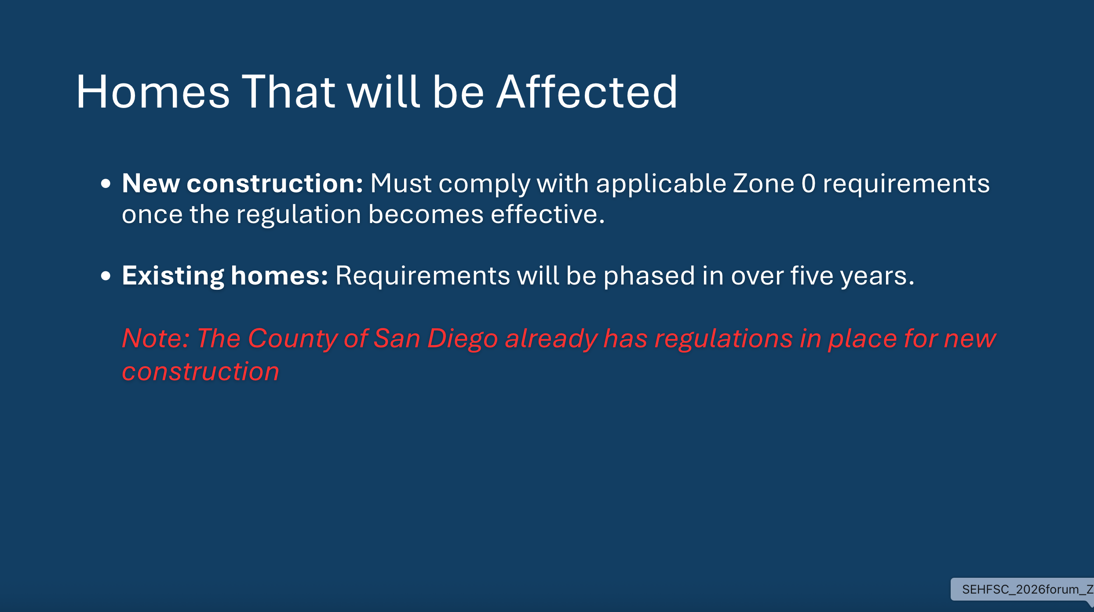
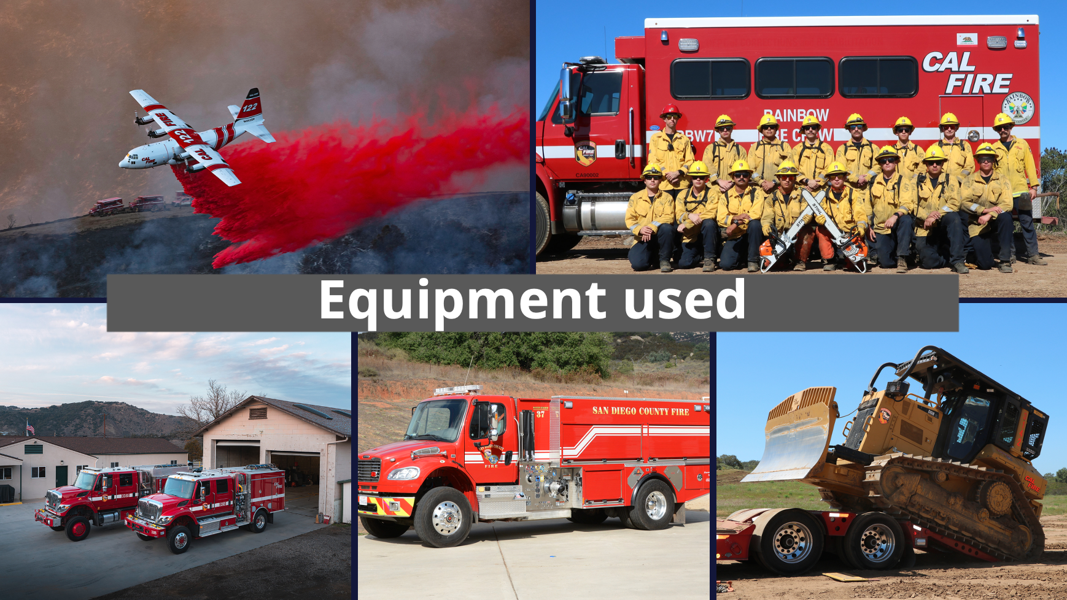

Slide 57
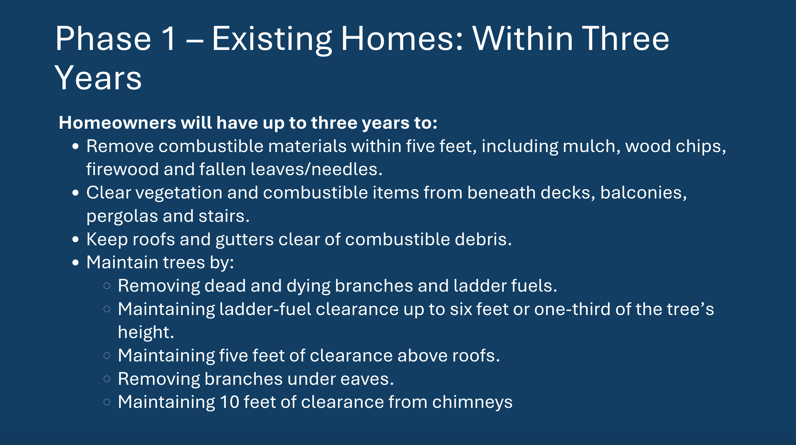
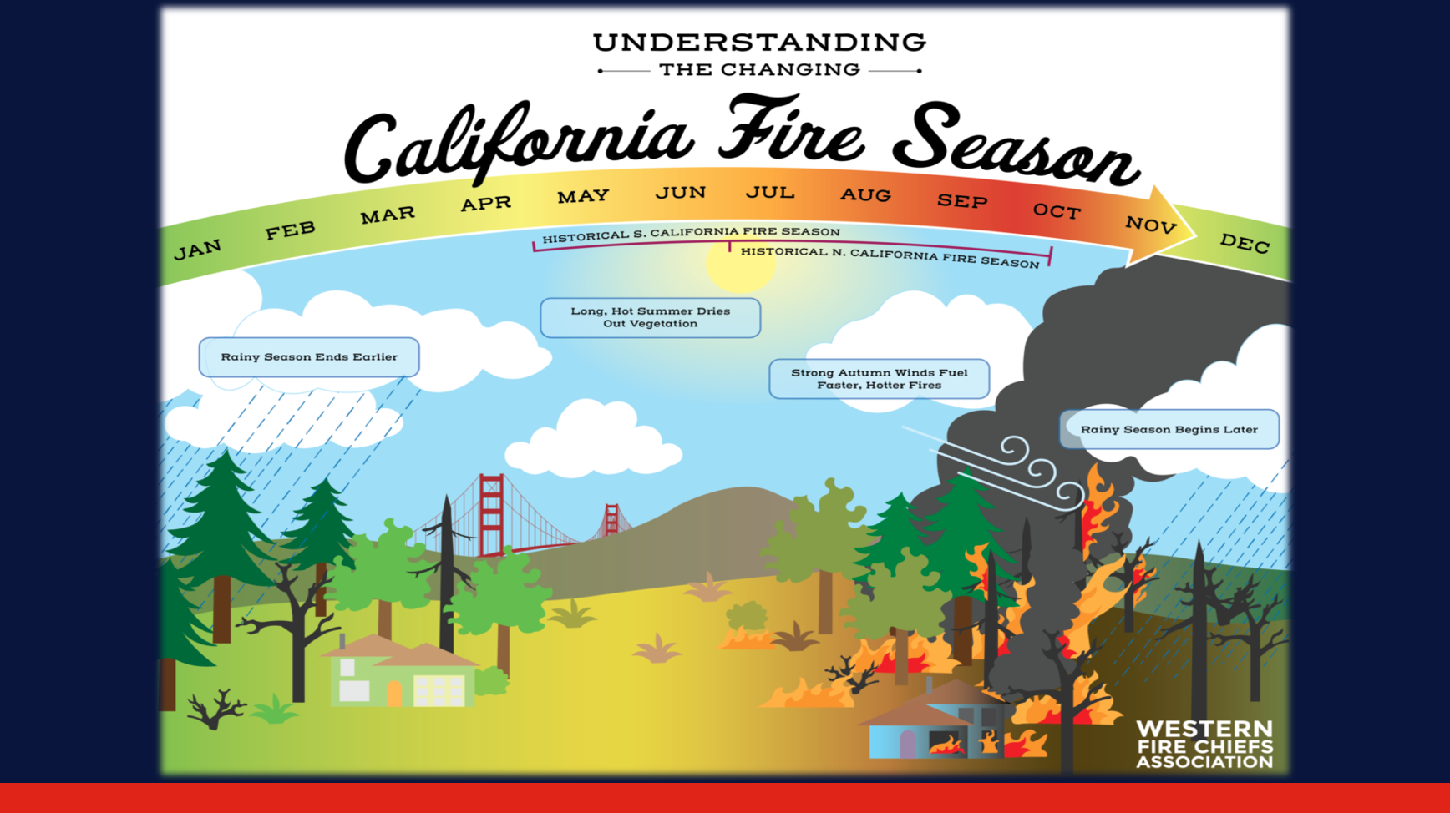

Slide 58
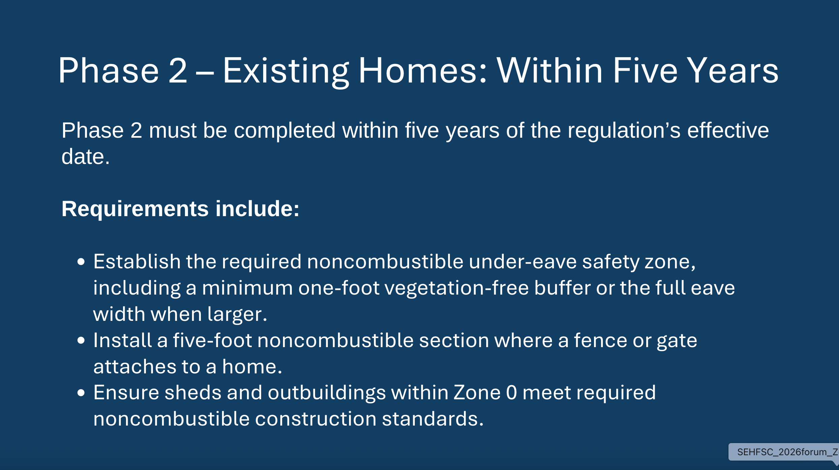
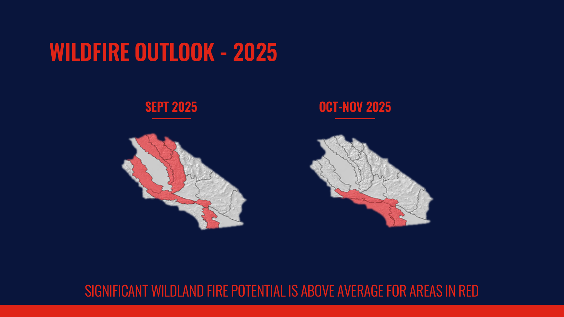

Slide 59
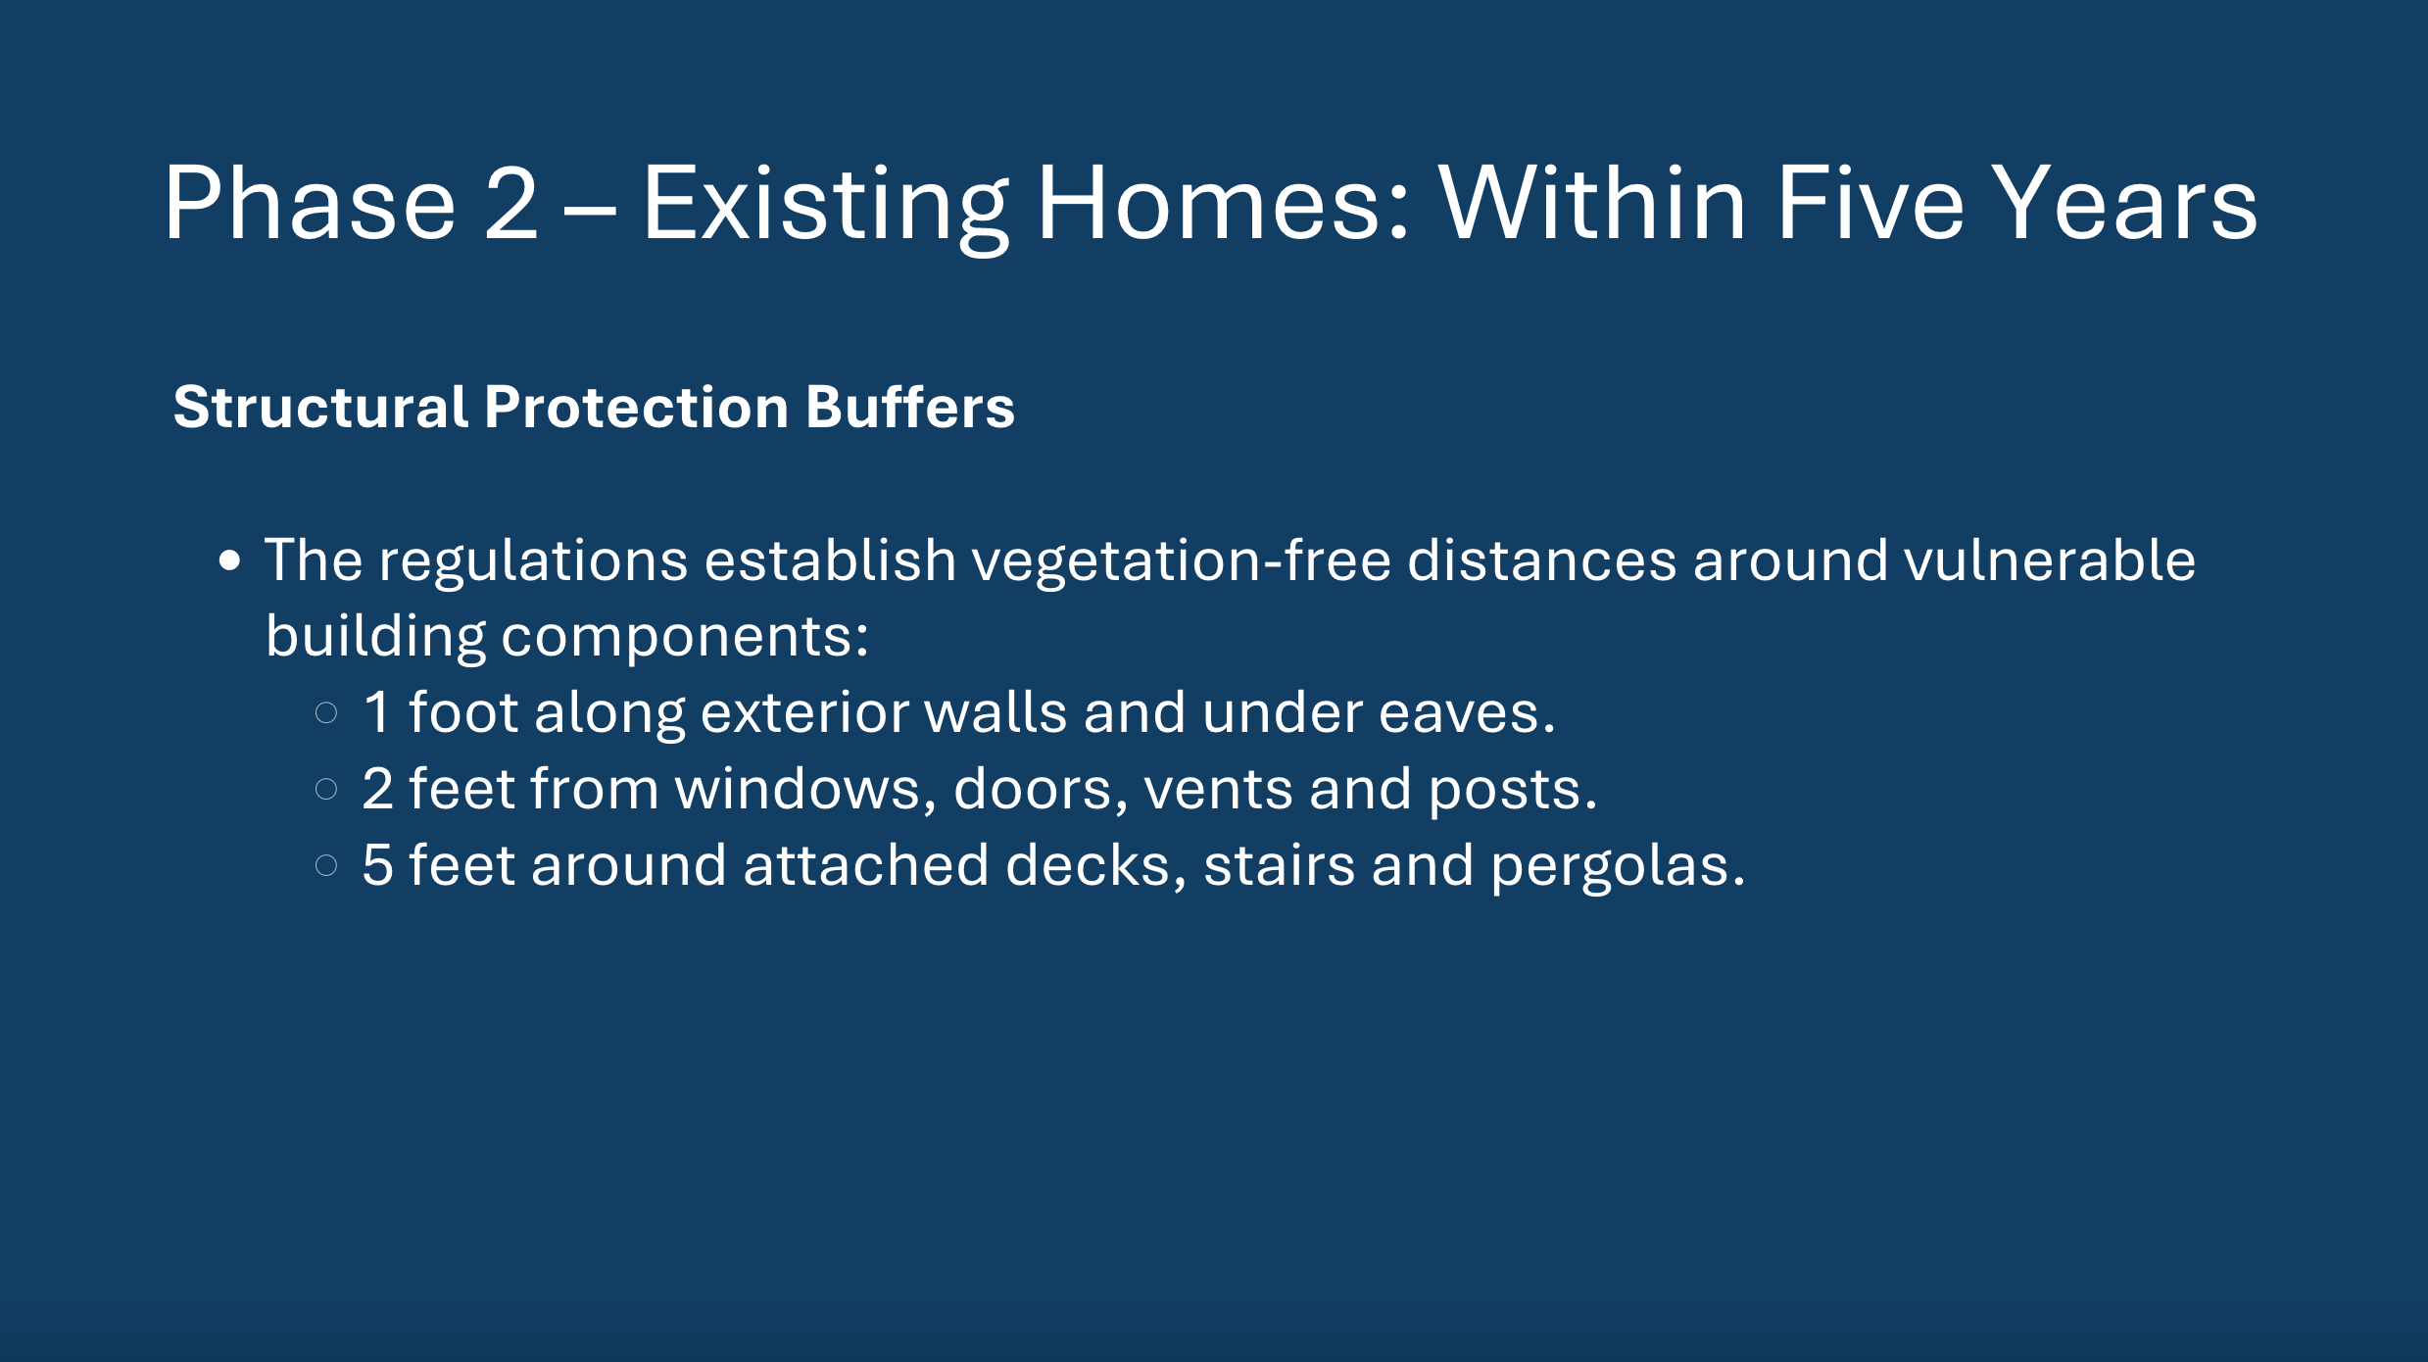
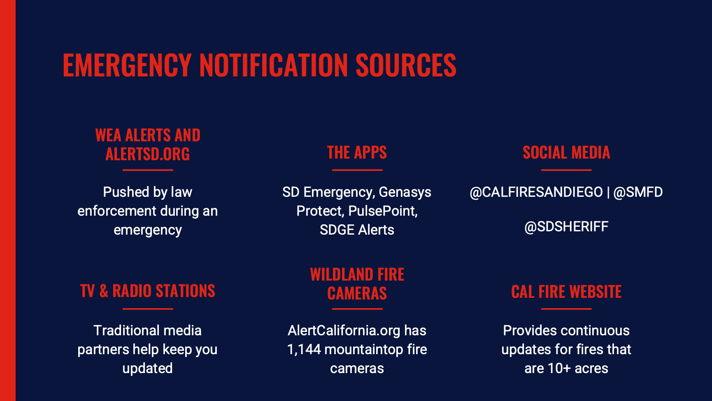

Slide 60



Slide 61



Slide 62



Slide 63


Slide 64



GRANT LAUNCH - TONIGHT

Slide 65

We Invest. You Invest. Together, We Reduce Risk.
Remove trees and combustible vegetation within Zone 0
Minimum dollar-for-dollar homeowner match required
Reimbursement-Based Program

Slide 66




Slide 67
THANK YOU
FOR COMING
Visit the Agency & Resource Tables for Q&A
Questions? Email Info@sehfsc.org
A recording of tonight’s forum will be available
for viewing on our YouTube channel:
https://www.youtube.com/@SEHFSC

